Slide 1
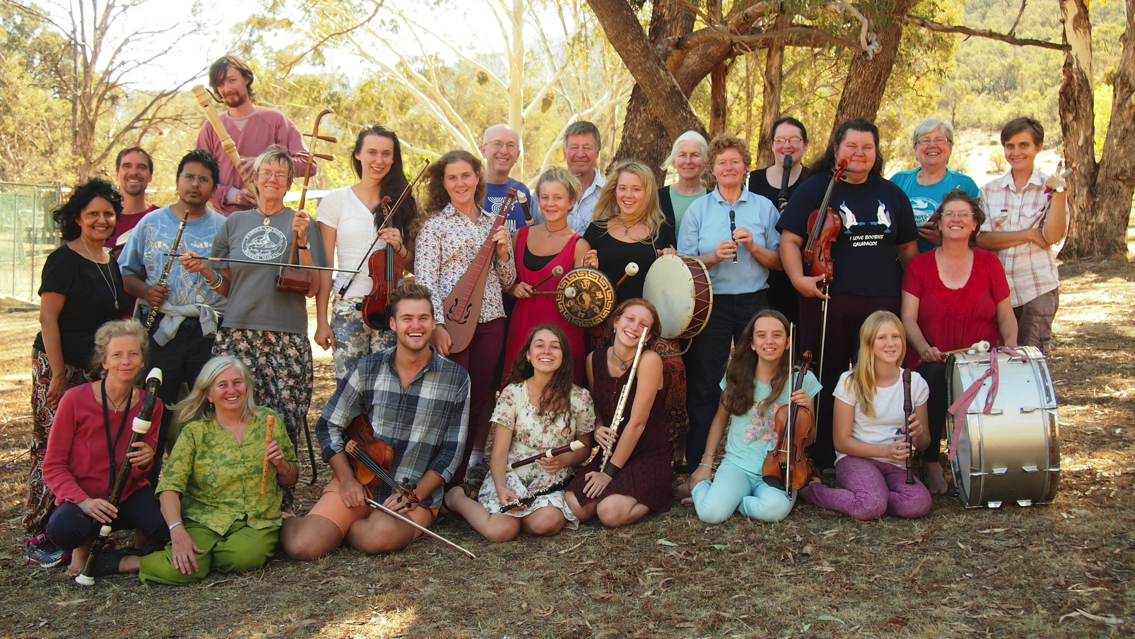
2014
24 Australian performers from many parts of Eastern Australia came together to rehearse my opera Marco, after which we travelled to Taiwan where we rehearsed with 60 Taiwanese performers, forming two casts. We performed the opera and choral music around Taiwan and in Hokkaido, Japan.

Slide 2
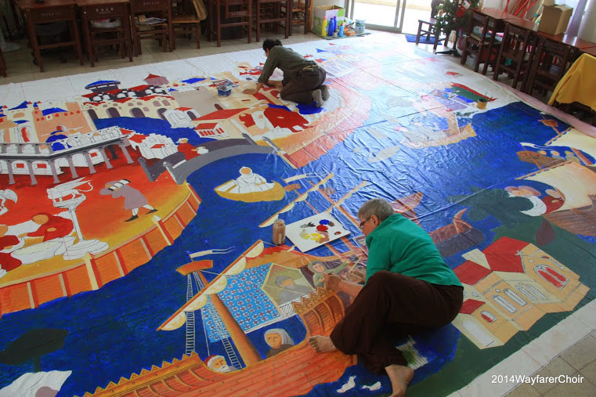
Jiren Lai and I spent untold hours scaling up, drawing and finally painting a huge backdrop for the opera Marco, which is a faithful copy of a mediaeval depiction of the departure of the Polos from Venice.

Slide 3
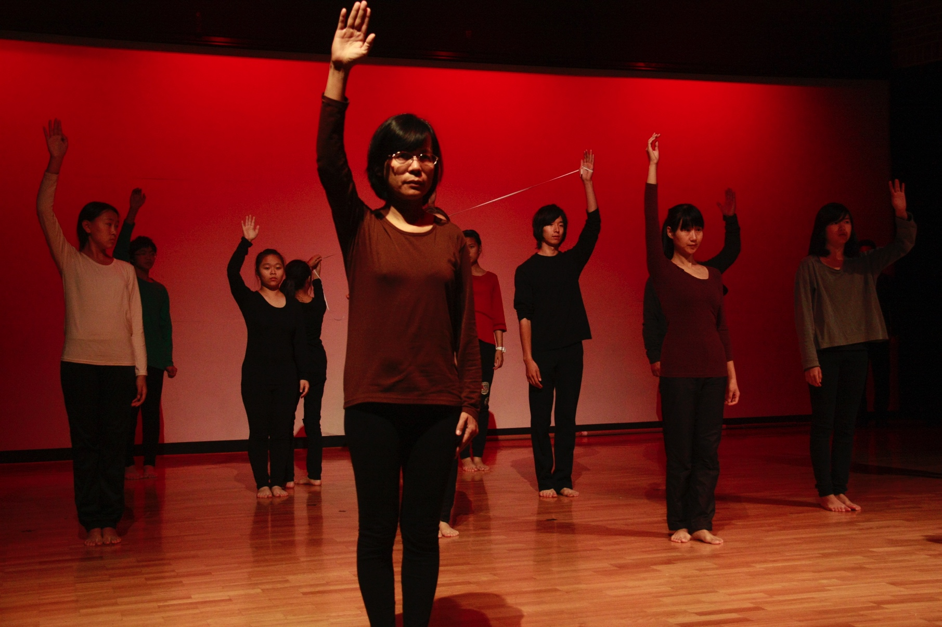
2015 Endangered
In July 2015, 90 Wayfarers from Taiwan, China and Japan spent 6 weeks in Australia. The first two weeks consisted of music workshops with many excellent Australian musicians. The next two weeks consisted of intensive rehearsals of my new music theatre piece ‘Endangered’ – looking at the creatures in danger of extinction in Taiwan, China, Japan and Australia.

Slide 4
The crested Ibis, once ubiquitious in Taiwan, China and Japan – thanks to nature lovers, now reviving.

Slide 5
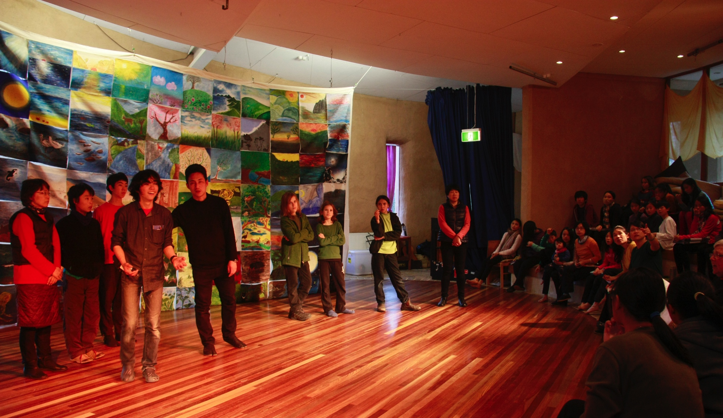
Each 2015 Wayfarer painted on a small (12 inches) a creature or other physical aspect of the natural world. The 88 paintings were mounted together and contributed a backdrop to some scenes in Endangered.

Slide 6
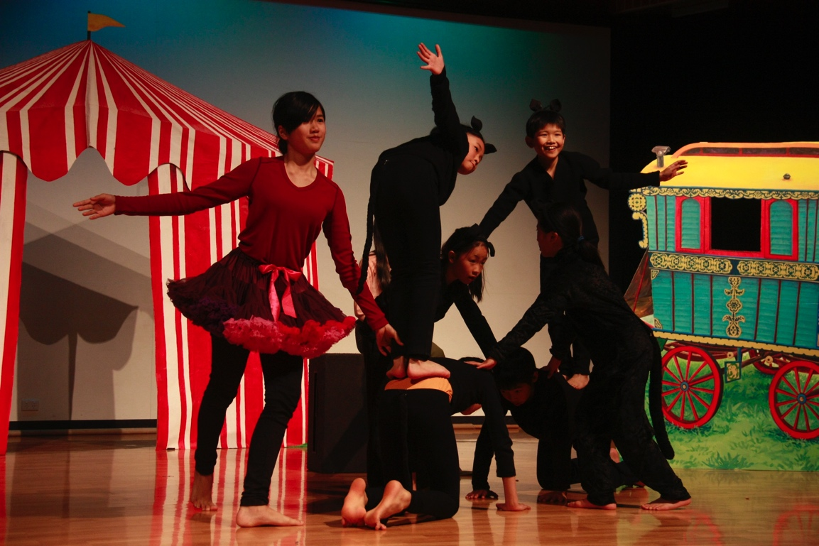
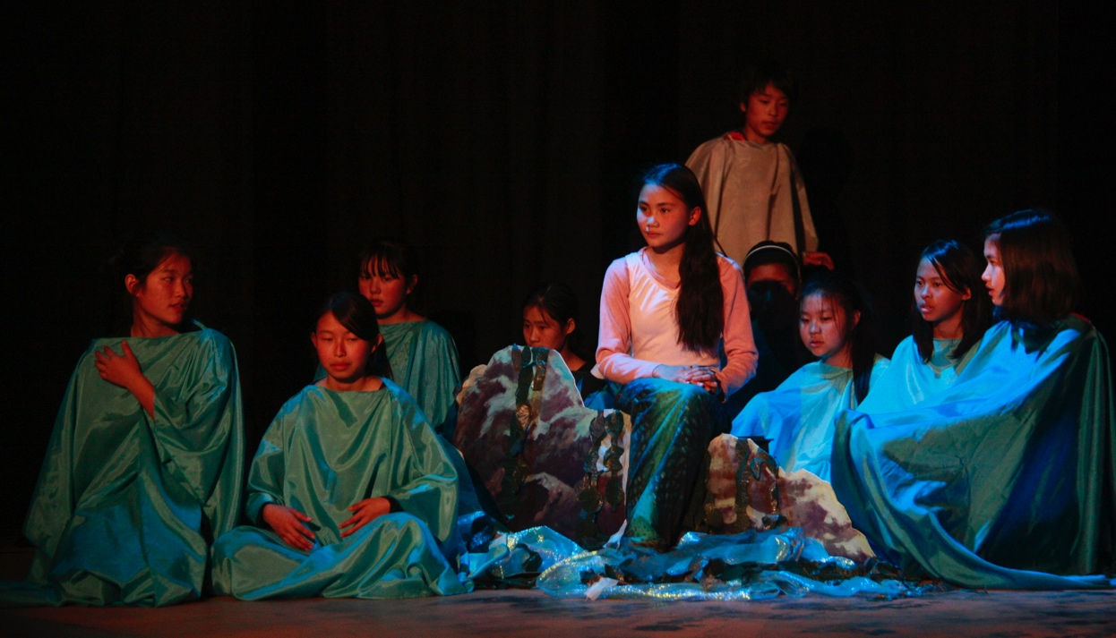
2015 The Singing Mermaid
my musical adaptation of Julia Donaldson’s story.
The Japanese students contributed hugely to the circus scenes!

Slide 7
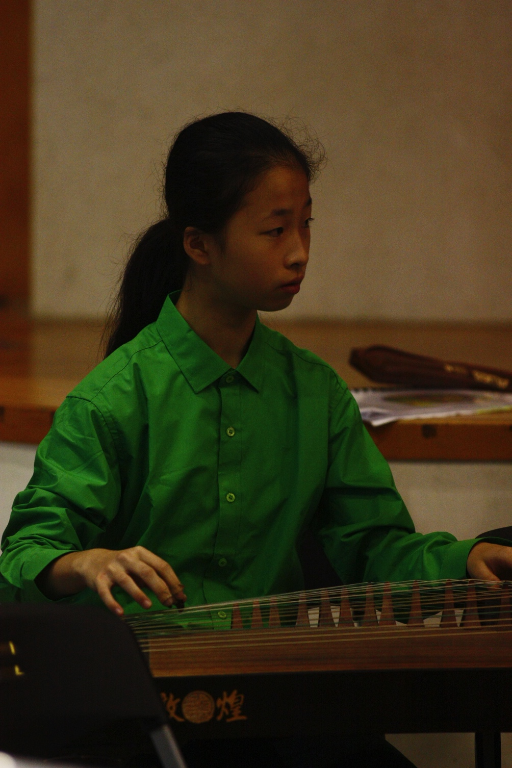
In 2016, I wrote a mini-opera Heavenly Grandfather’s Banquet and included a part for the Guzheng. Luckily, there were two very good Guzheng players in Taiwanese Wayfarers.

Slide 8
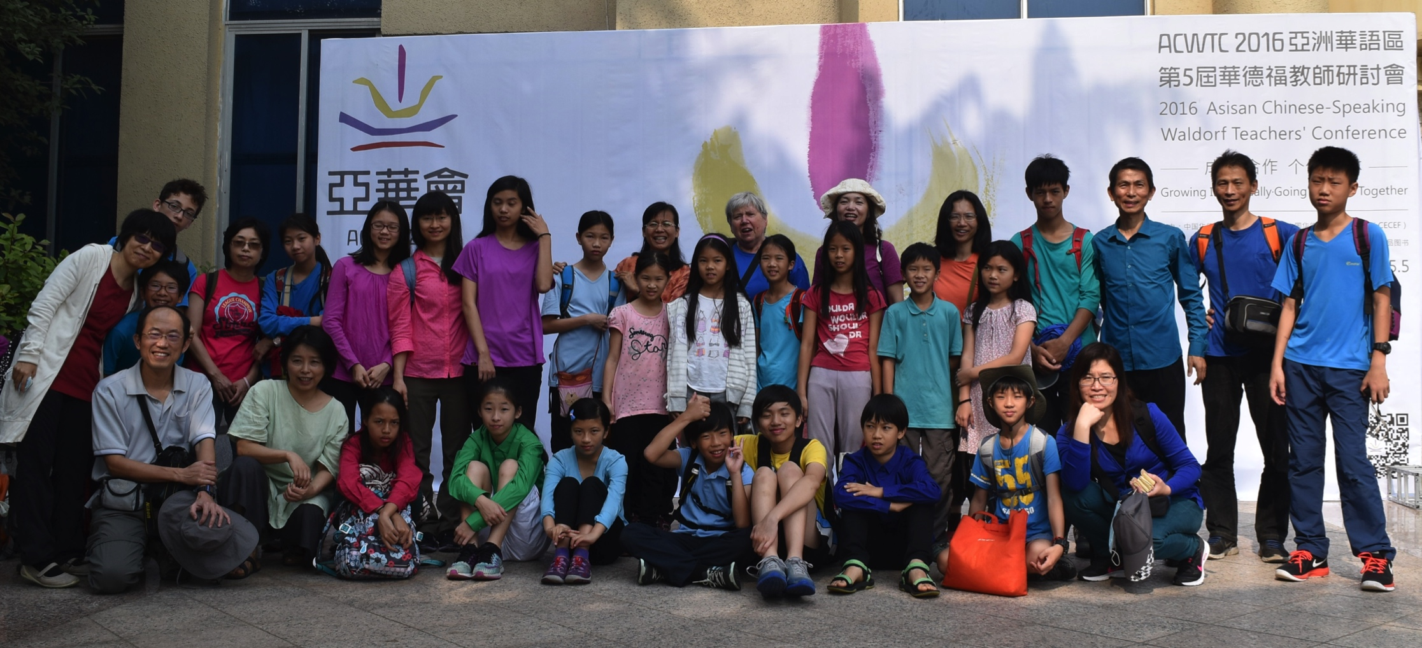
2016 China Tour
About 50 Taiwanese Wayfarers of all ages rehearsed Heavenly Grandfather’s Banquet in Taiwan, also sewing costumes and painting animal headdresses. We then toured China, performing at the Asian Chinese-Speaking Waldorf Teacher Conference as well as at the Chengdu Waldorf School.

Slide 9
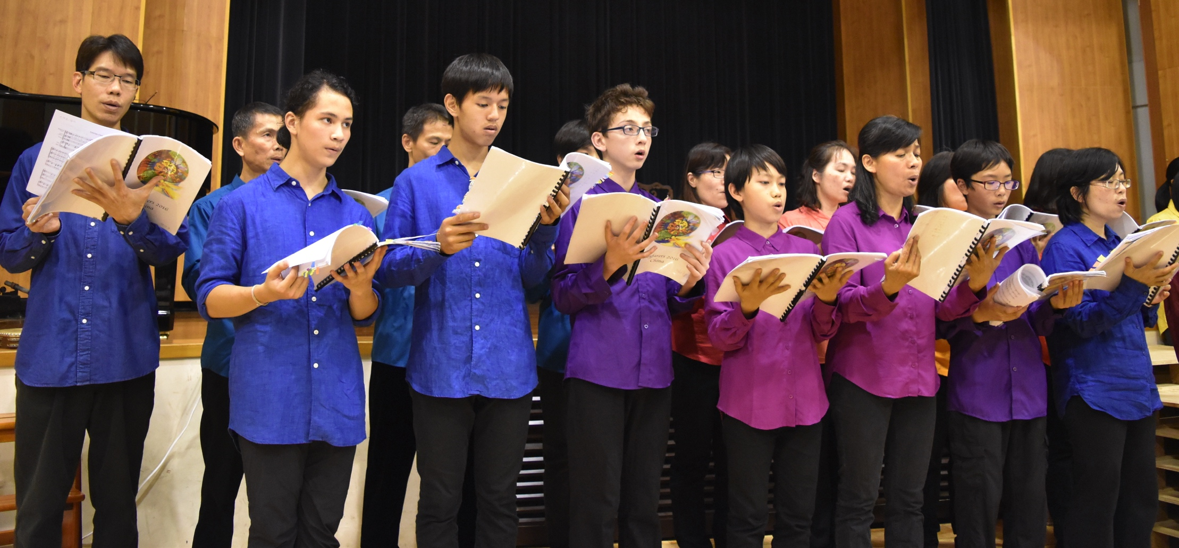
2016 Taiwanese Wayfarers – we were fortunate to have a good, solid cohort of boys and men!

Slide 10
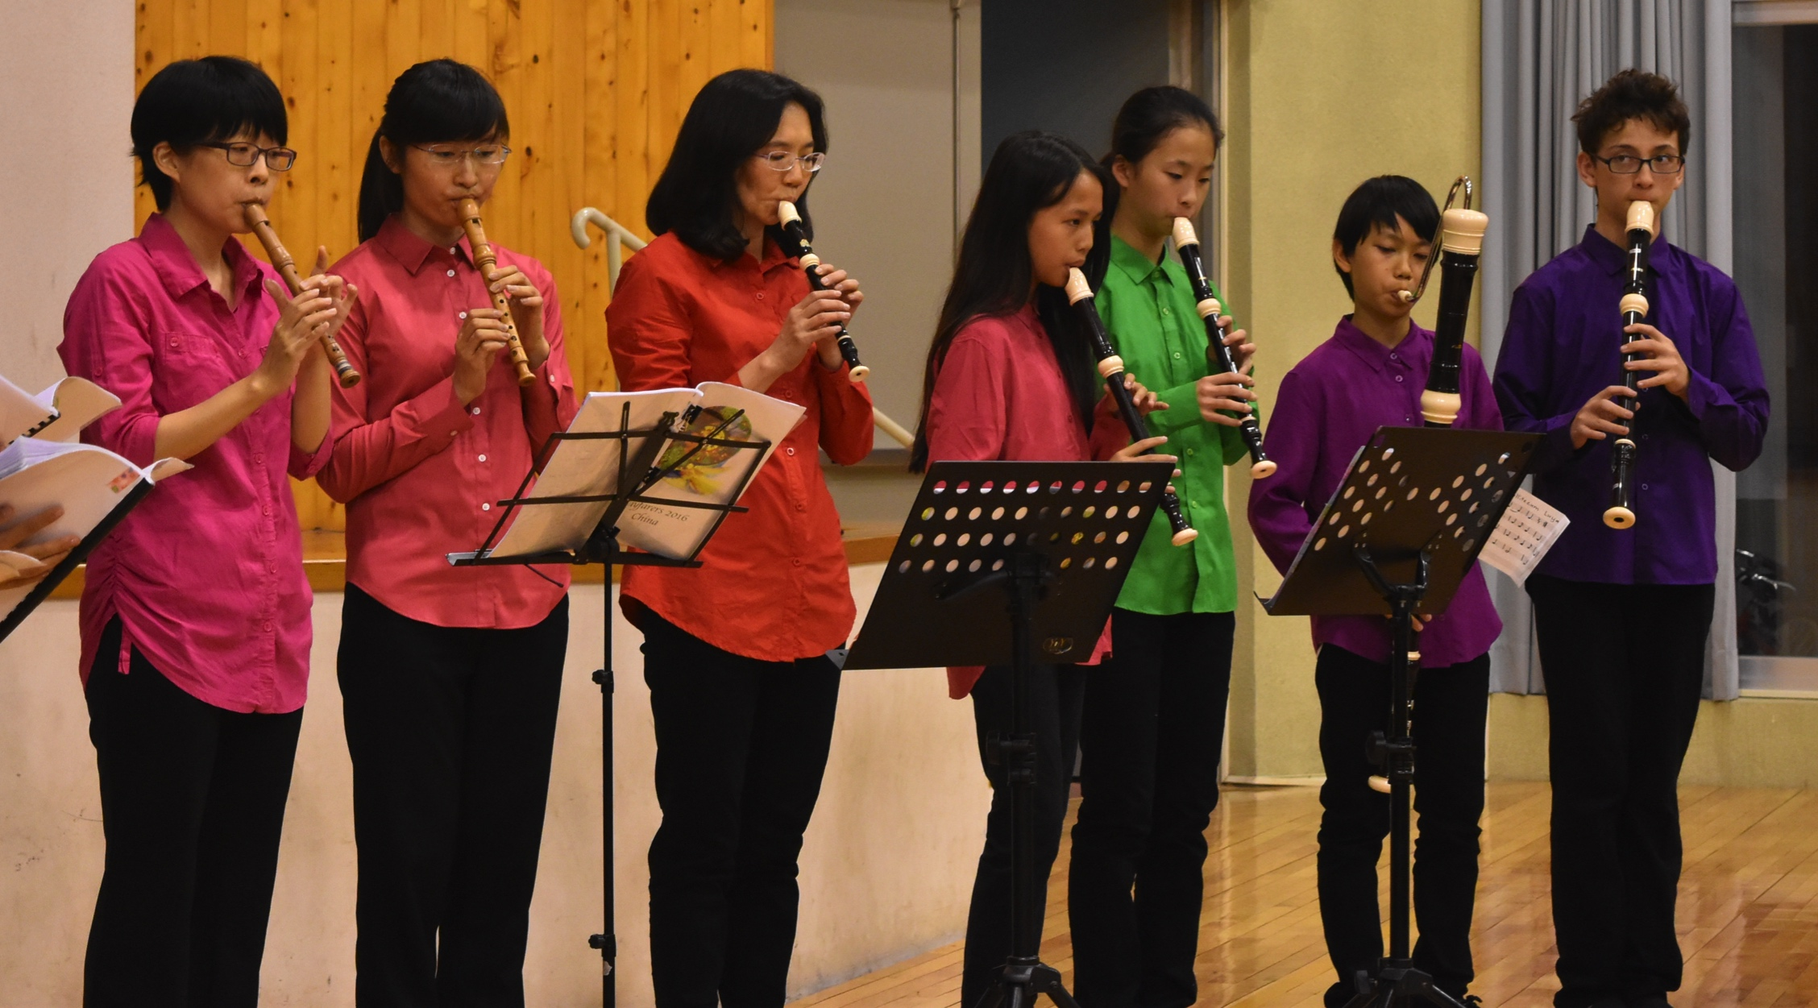
2016 Taiwanese recorder performers (recorder teaching is now very solid at the Ci-Xin Waldorf School in Taiwan)

Slide 11
Heavenly Grandfather’s Banquet
Heavenly Grandfather’s Banquet (2016) tells the story of how the Jade Emperor chose the twelve animals for the Chinese zodiac.

Slide 12
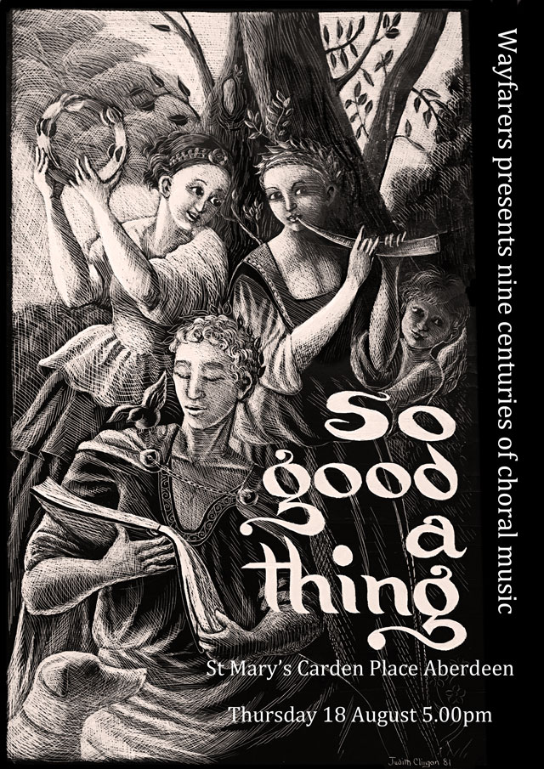
2nd 2016 tour - Europe
11 Australians joined with 11 Taiwanese Wayfarers to tour Taiwan, Scotland (Edinburgh Fringe), Iceland, Ireland, England, France and Switzerland

Slide 13
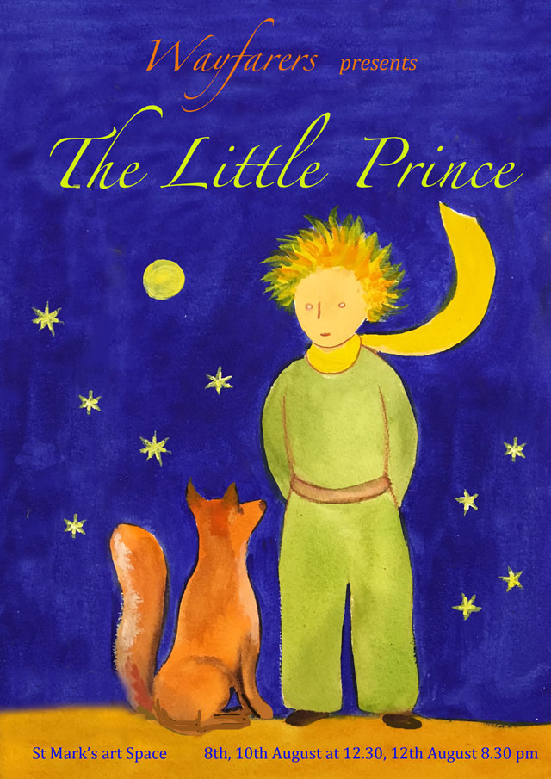
I translated Antoine de Saint-Exupery’s novella The Little Prince, turned it into a play, and wrote songs and incidental music to suit the story.
2016 Wayfarers performed this at the Edinburgh Fringe Festival and elsewhere in Europe.

Slide 14
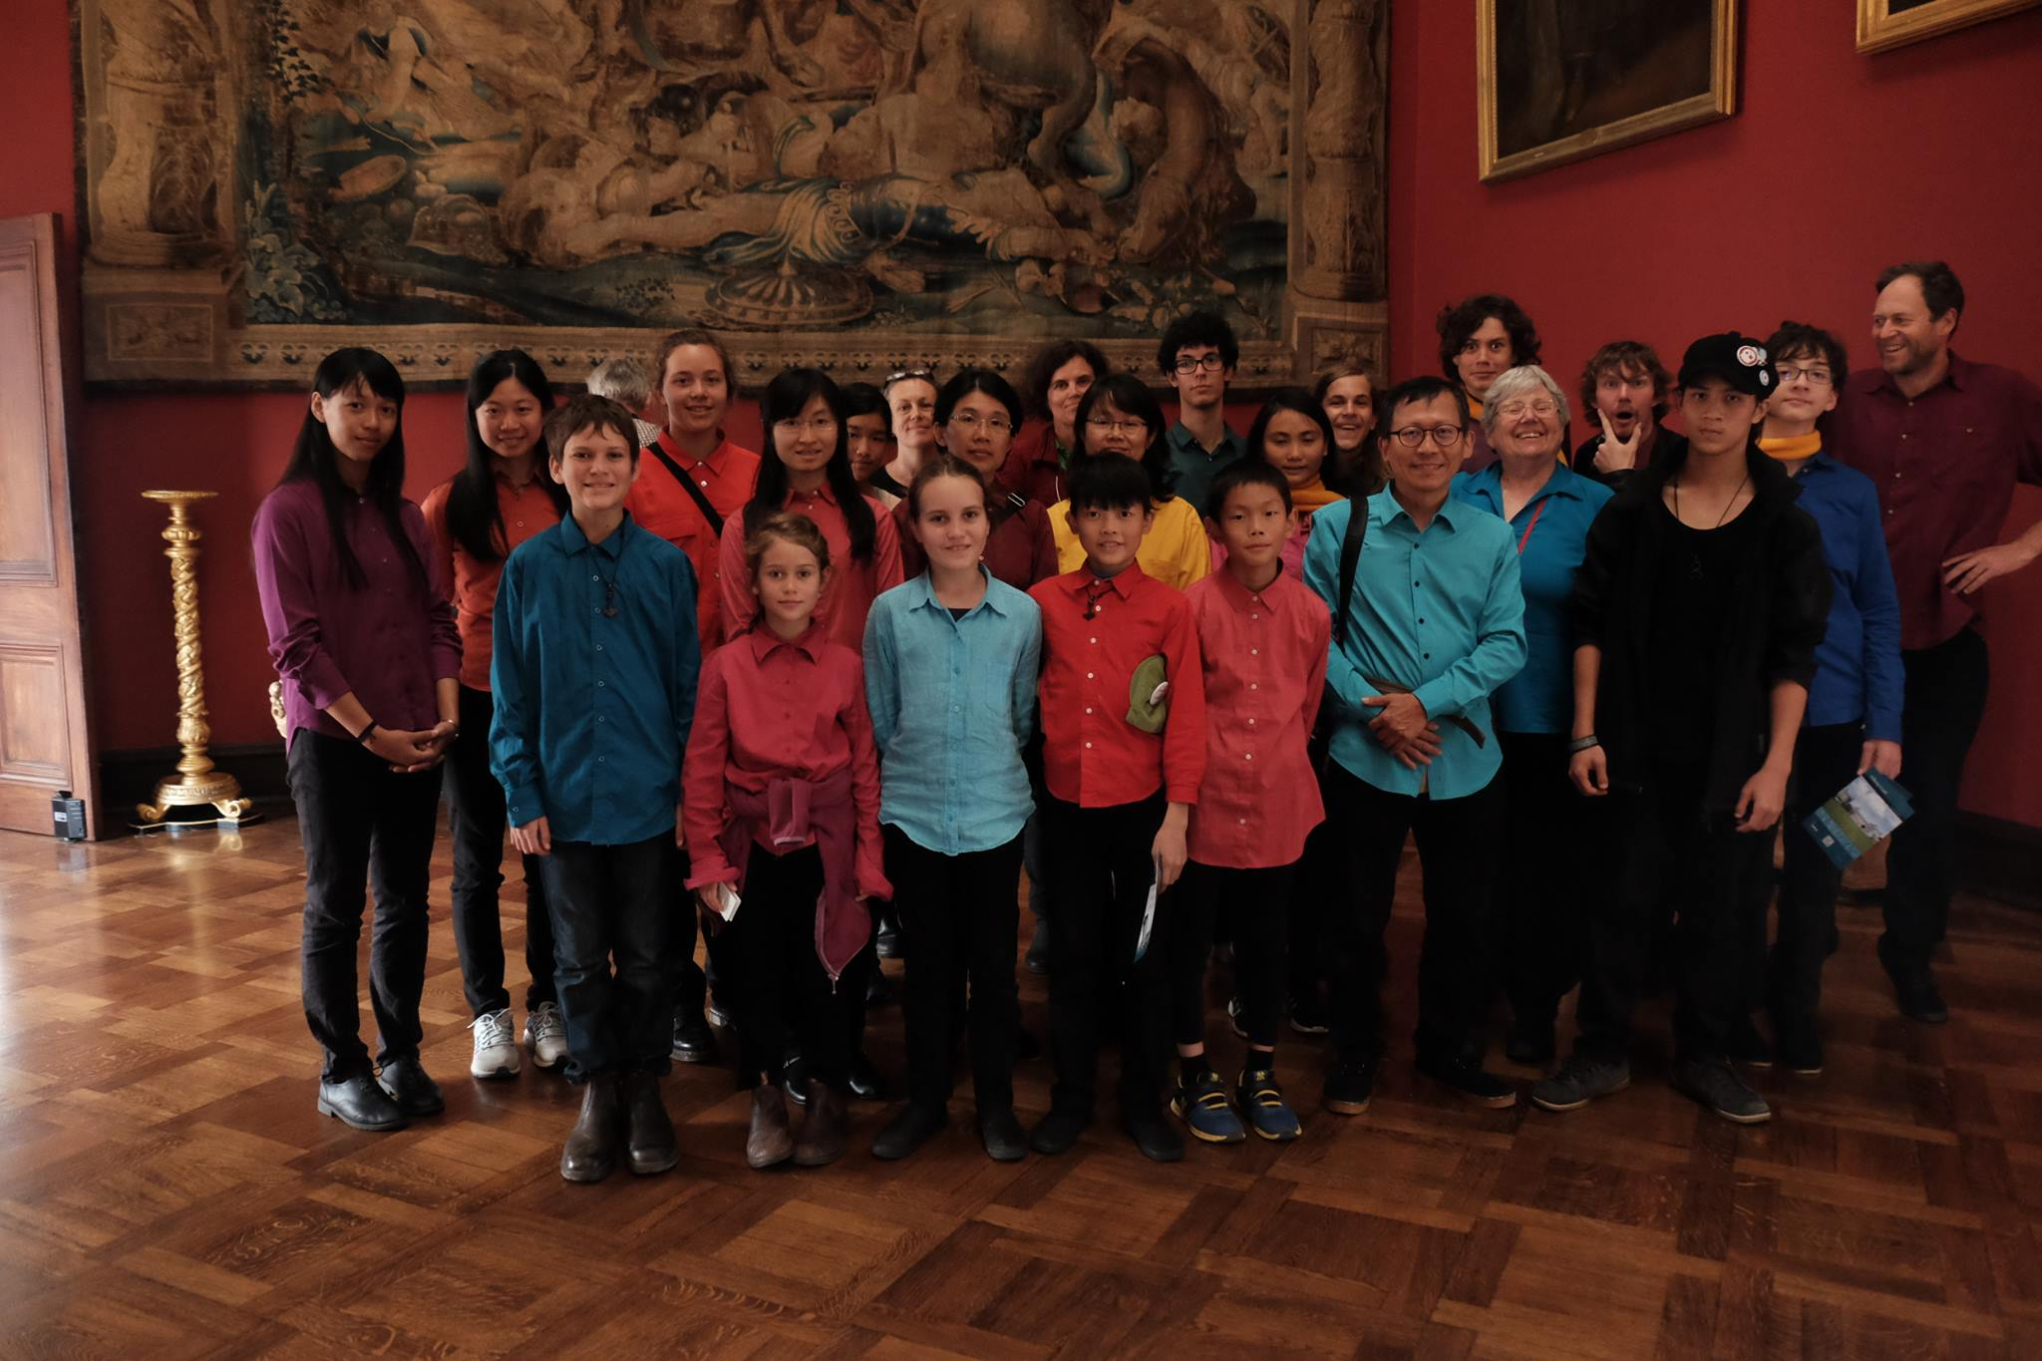
2016 Wayfarers (11 Australians, 11 Taiwanese aged 7-71) in Kilkenny Castle, Ireland.

Slide 15
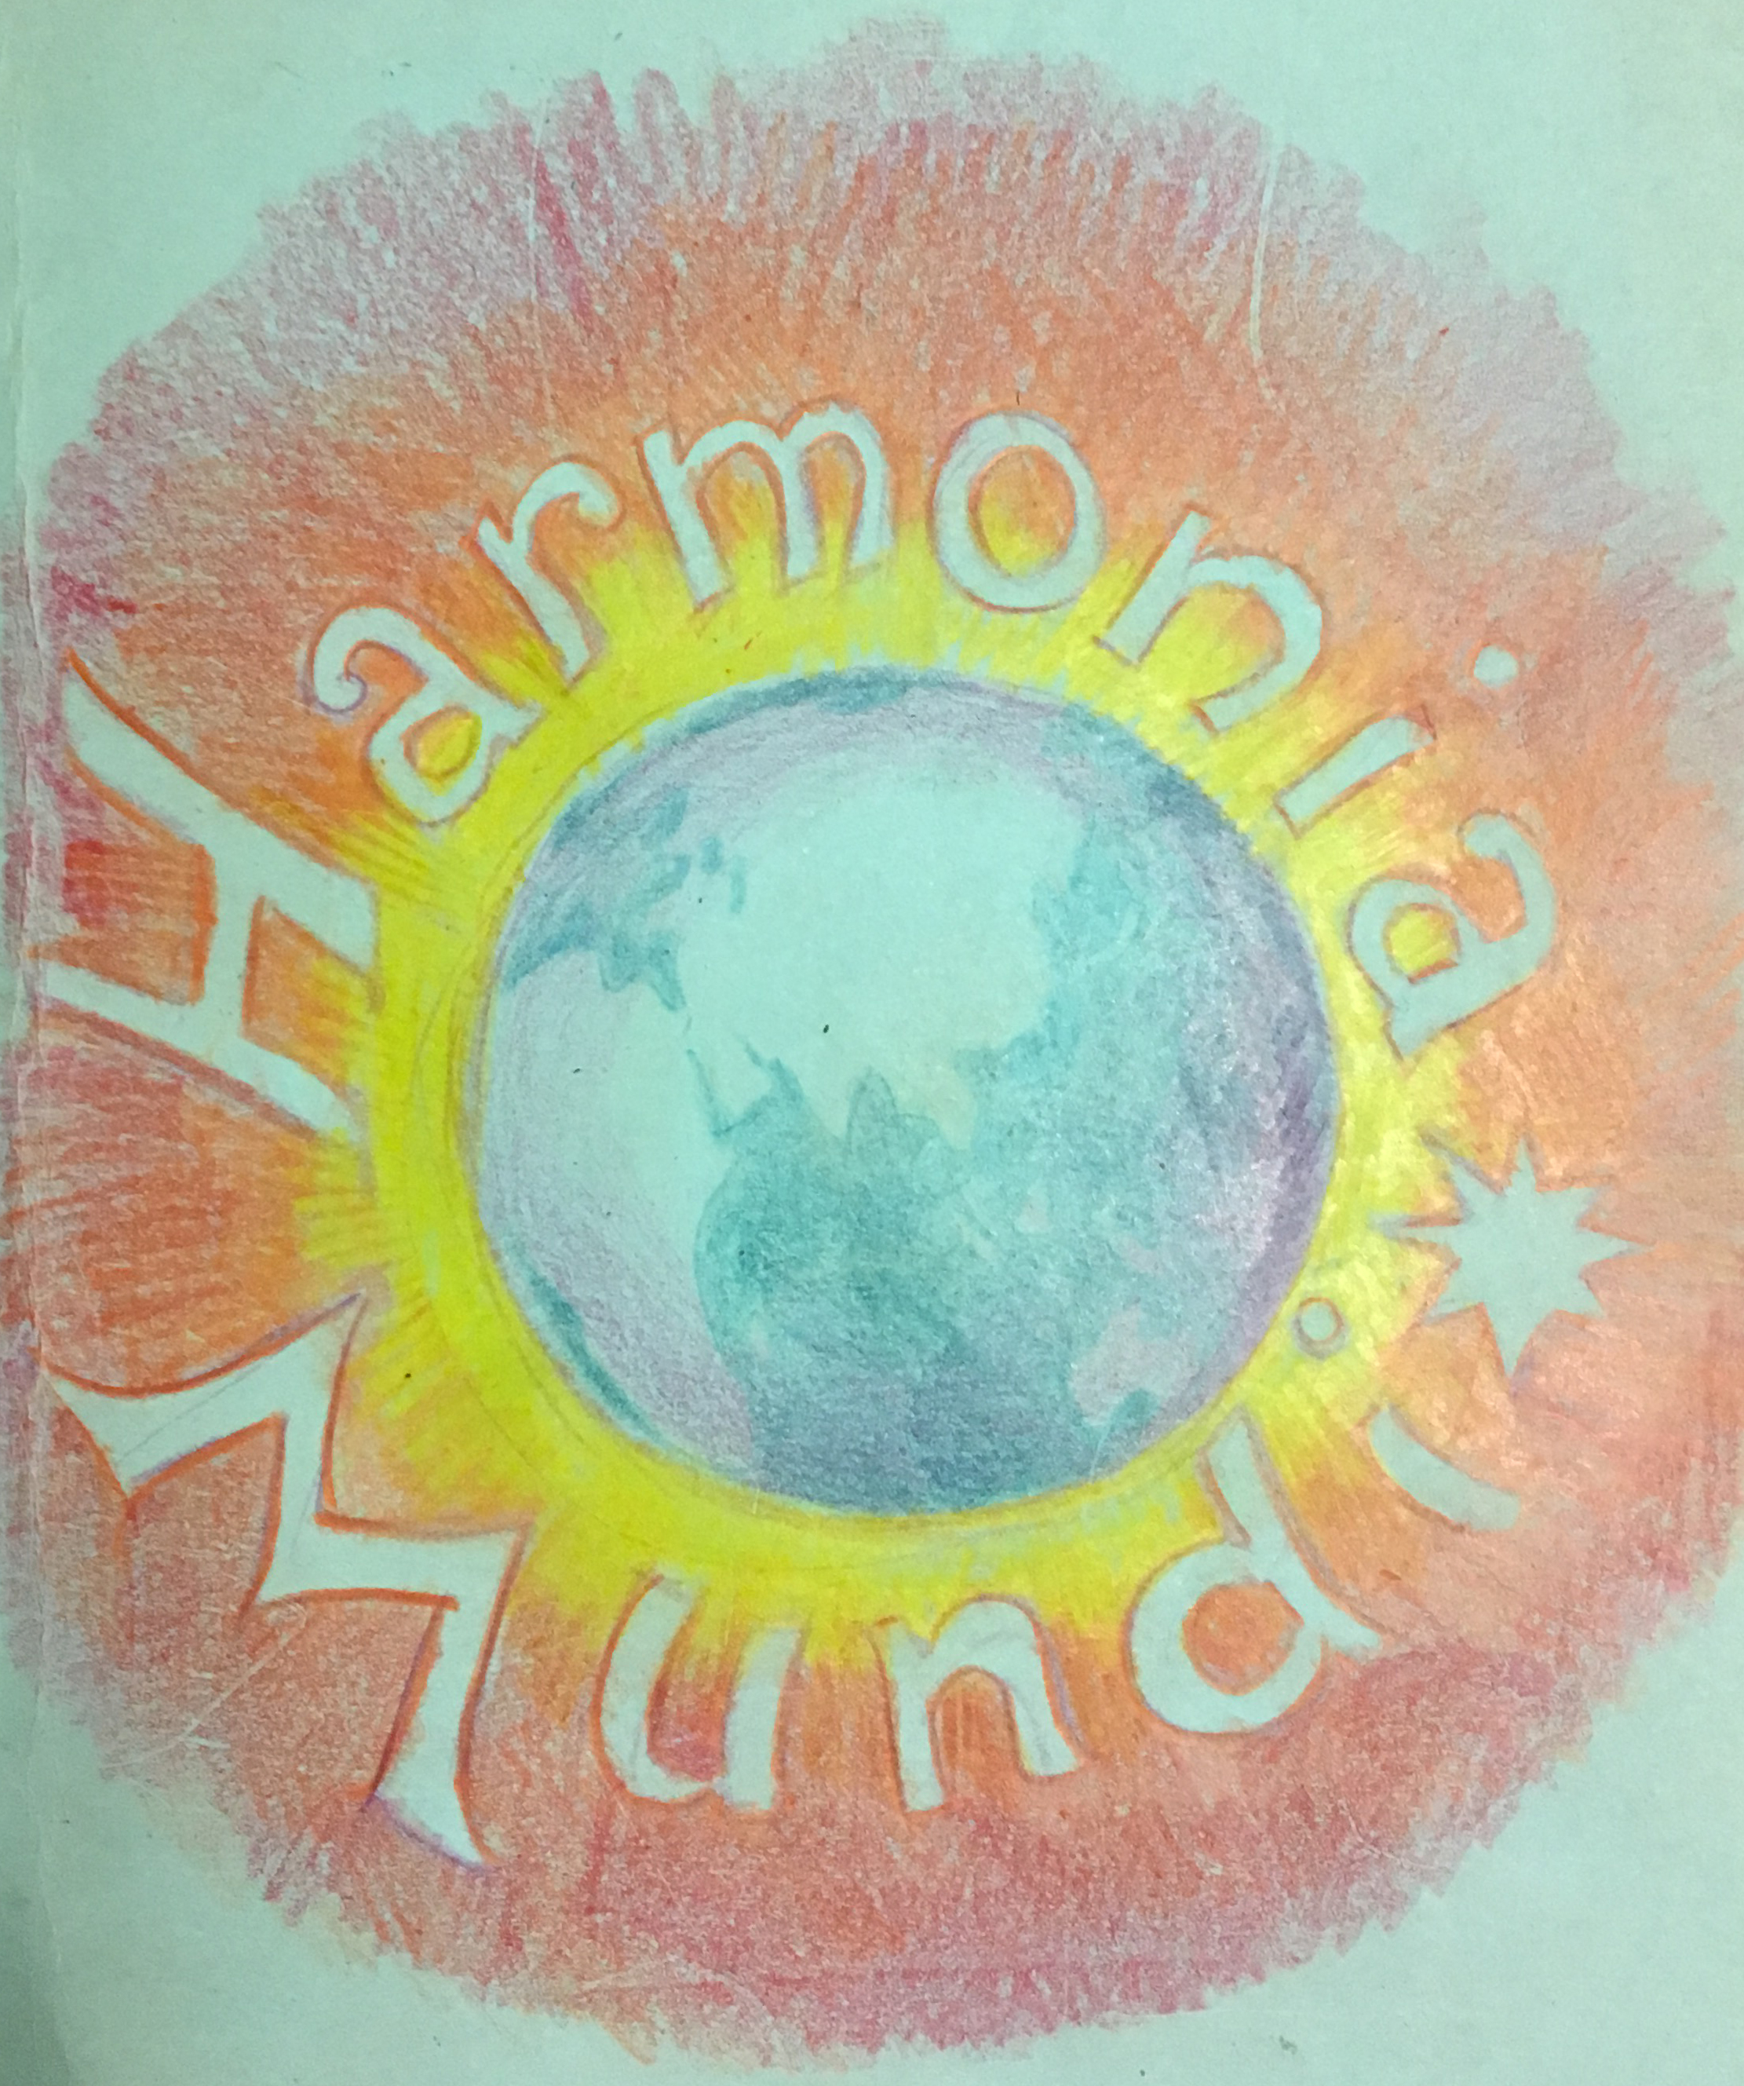
2017 Tour of Japan and Korea
For this tour I wrote both words and music of Harmonia Mundi: music theatre for seven main actors, group actors (physical theatre), choir and orchestra, which looks at the choices facing us caring for the world and each other. 101 performers, mostly teenagers, came together from seven countries to rehearse for two weeks.

Slide 16
Full group, including orchestra, performing choral music for parents in
Hokkaido Steiner School in Japan

Slide 17
Movers trying on costumes – Judy’s daughter, Jess Dixon came to Japan to teach the physical theatre component of Harmonia Mundi.

Slide 18
Actors in costumes: Tori Sophia Healer Gaia’s M Sol Nik Japan/Aus Aus Swiss Aus Taiwan Japan Aus

Slide 19
In December 2017 Wayfarers Australia performed The Little Prince in the Tuggeranong
Arts Centre, Canberra. The two main roles (the Aviator, Rohan Vicars and the Prince, Siggy Nock) were played by the same performers as in the Edinburgh Fringe 2016 tour. Luckily, Siggy, although by now 14, was still a soprano and still fitted into his costume!

