Slide 1
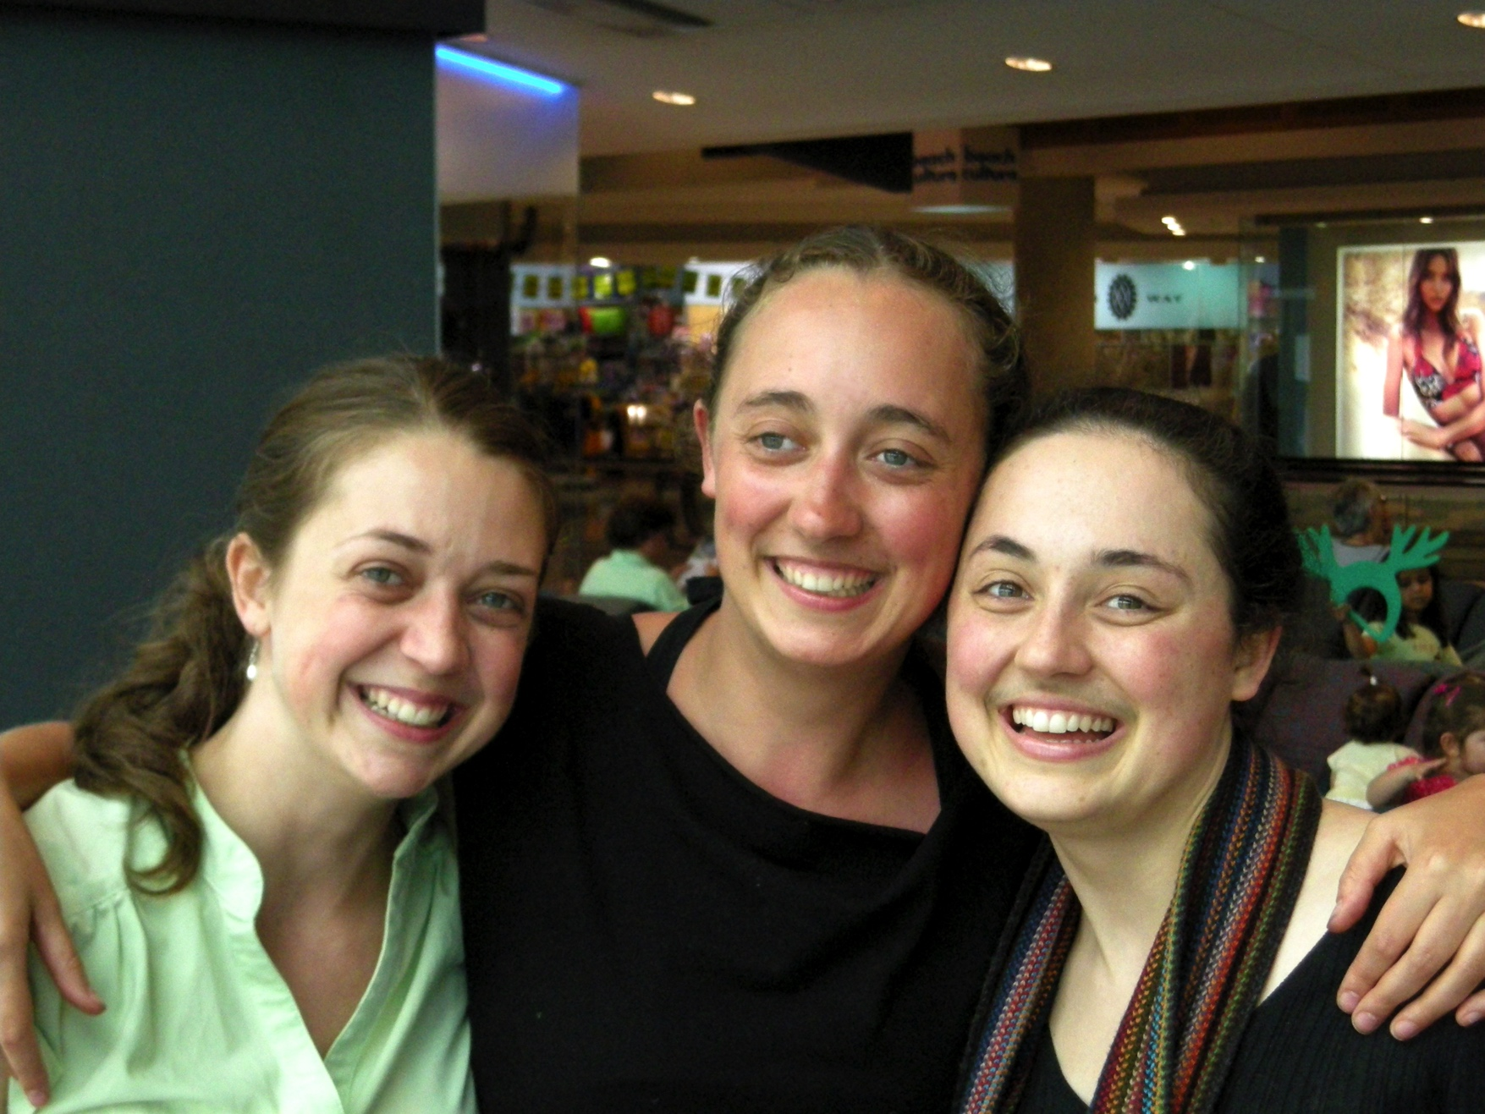
2007 Mazzone sisters Clara, Raphaela, Emilia - a mainstay of many Wayfarers tours has been one or more Mazzone performers!

Slide 2
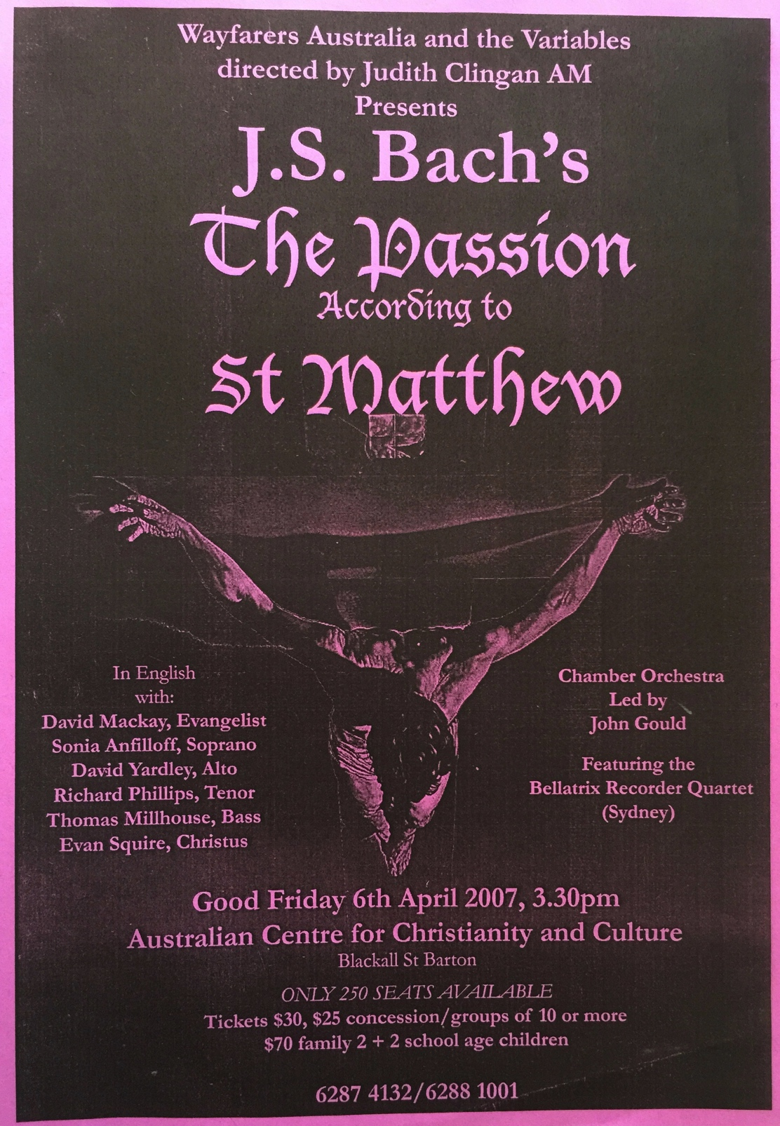
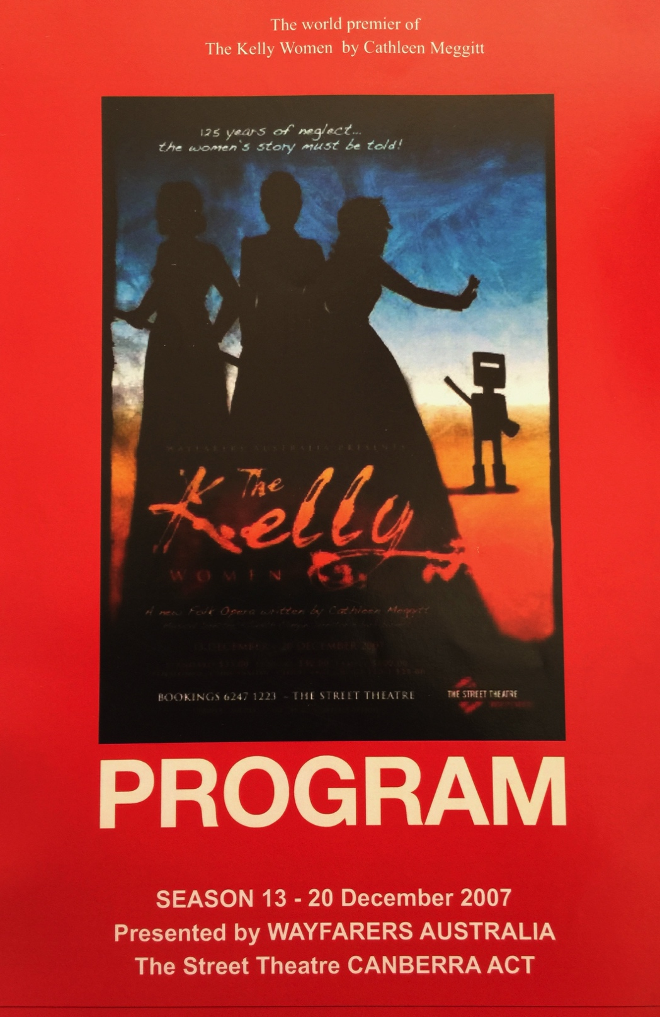
Large-scale Wayfarers performances in Canberra – Bach’s St Matthew Passion
and Cathleen Meggitt’s music theatre work, The Kelly Women
Notes:
Chorale of St Mattew
Video of The Kelly Women - bushdance

Slide 3
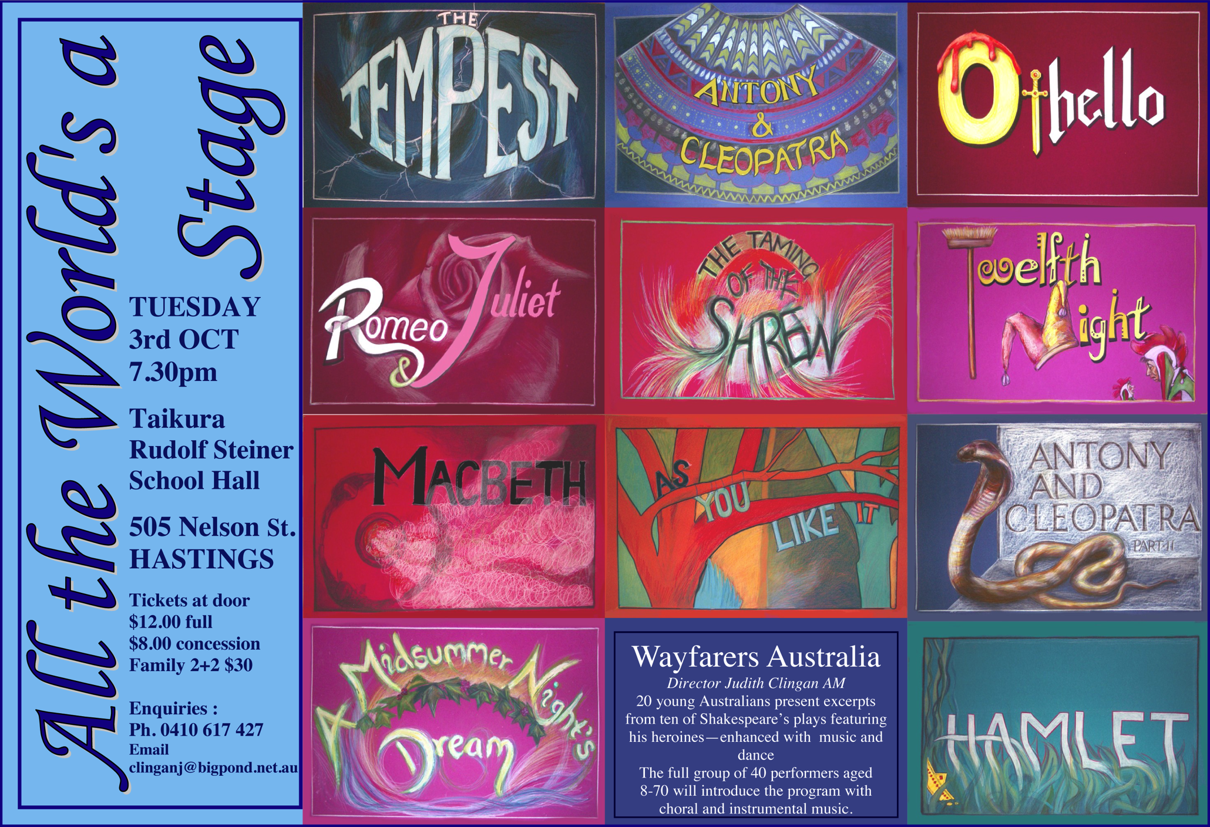
2007 wayfarers Tour of New Zealand with c.60 performers, including students and teachers from Samford Valley Steiner School, Brisbane. Here is Raphaela’s poster for our Shakespeare’s Girls music theatre

Slide 4
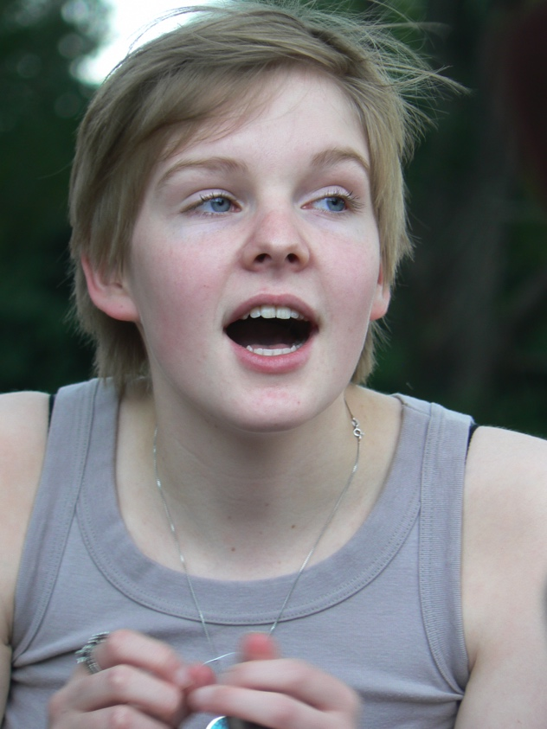
Grace Steele – Imagine and Wayfarers performer

Slide 5
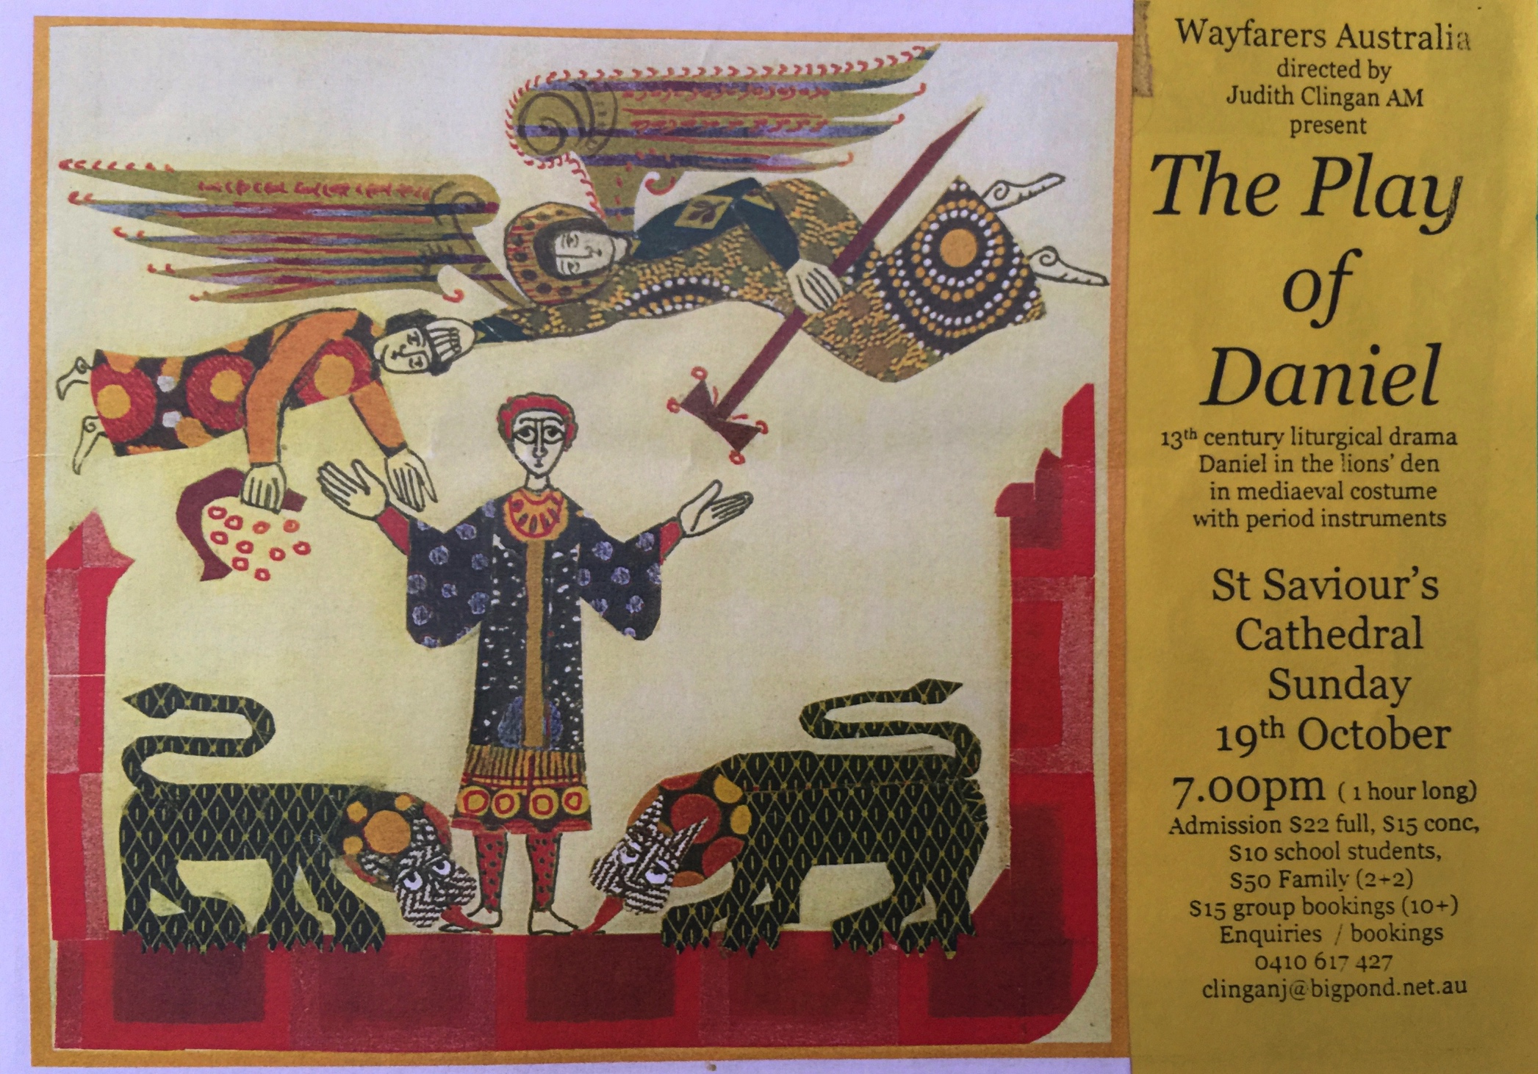

2007 & 2008 – Wayfarers performances of the
12th century liturgical Play of Daniel
Notes:
Conductors CD

Slide 6
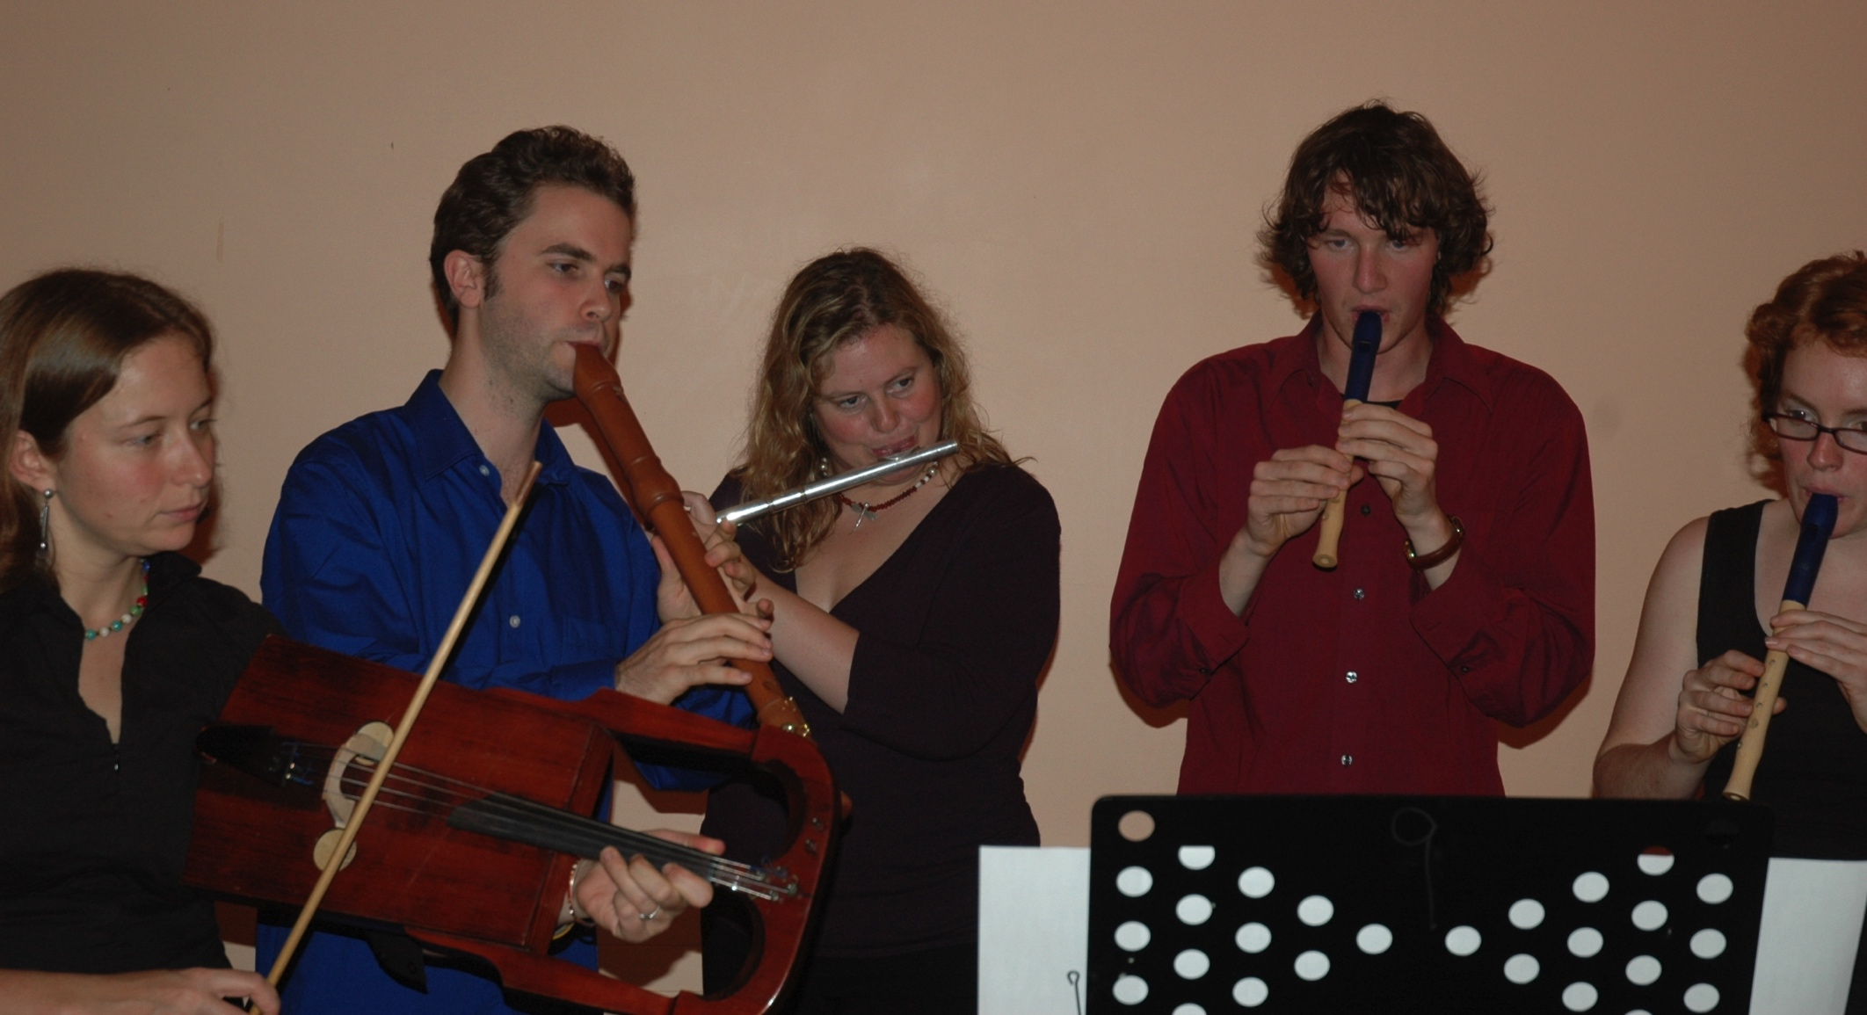
2008 – smaller New Zealand Wayfarers tour – c.10 young adults

Slide 7
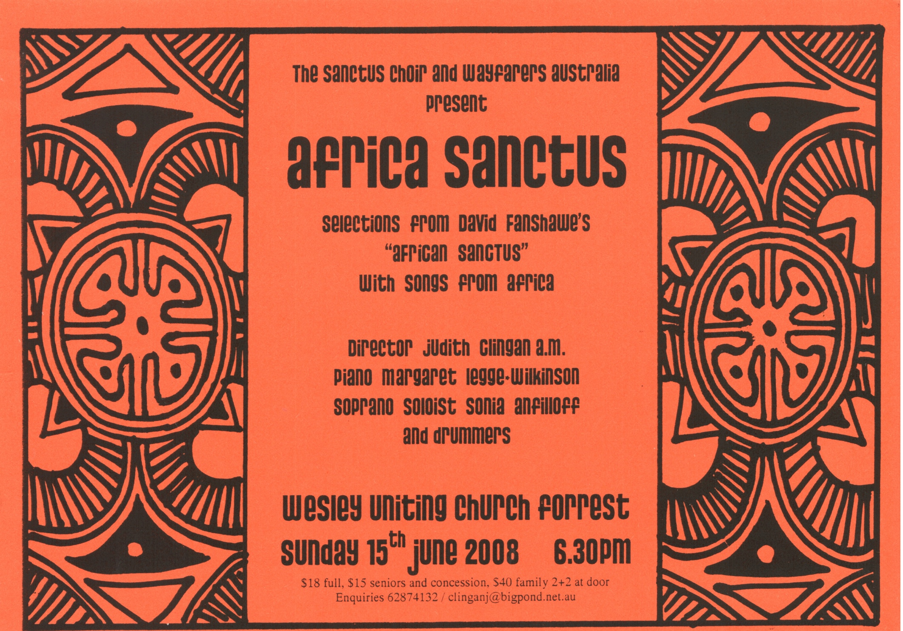
2008 – Wayfarers plus guest singers performed most of Fanshawe’s African Sanctus

Slide 8
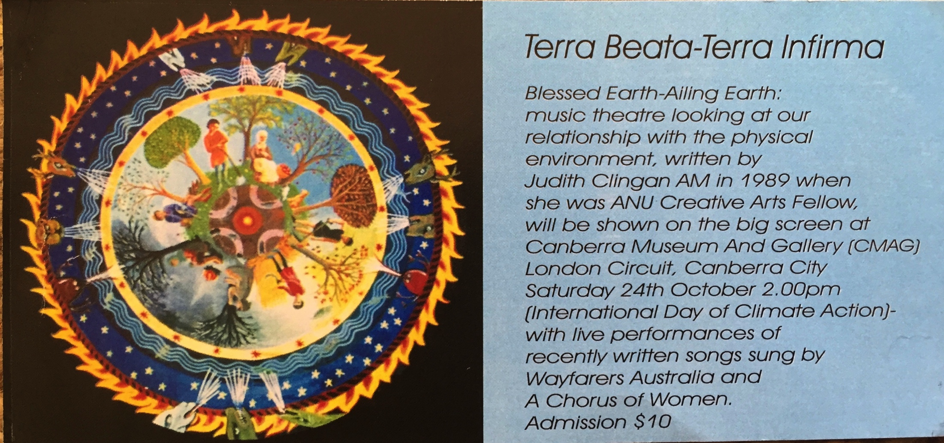
2009 – Canberra Wayfarers with A Chorus of Women performed new songs for the
International Day of Climate Action

Slide 9
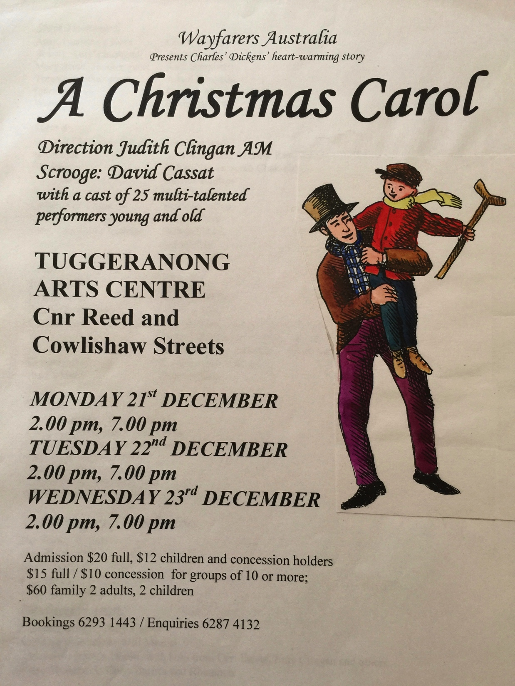
2010
Wayfarers Canberra performed Dickens’ A Christmas Carol (my script, with music)

Slide 10
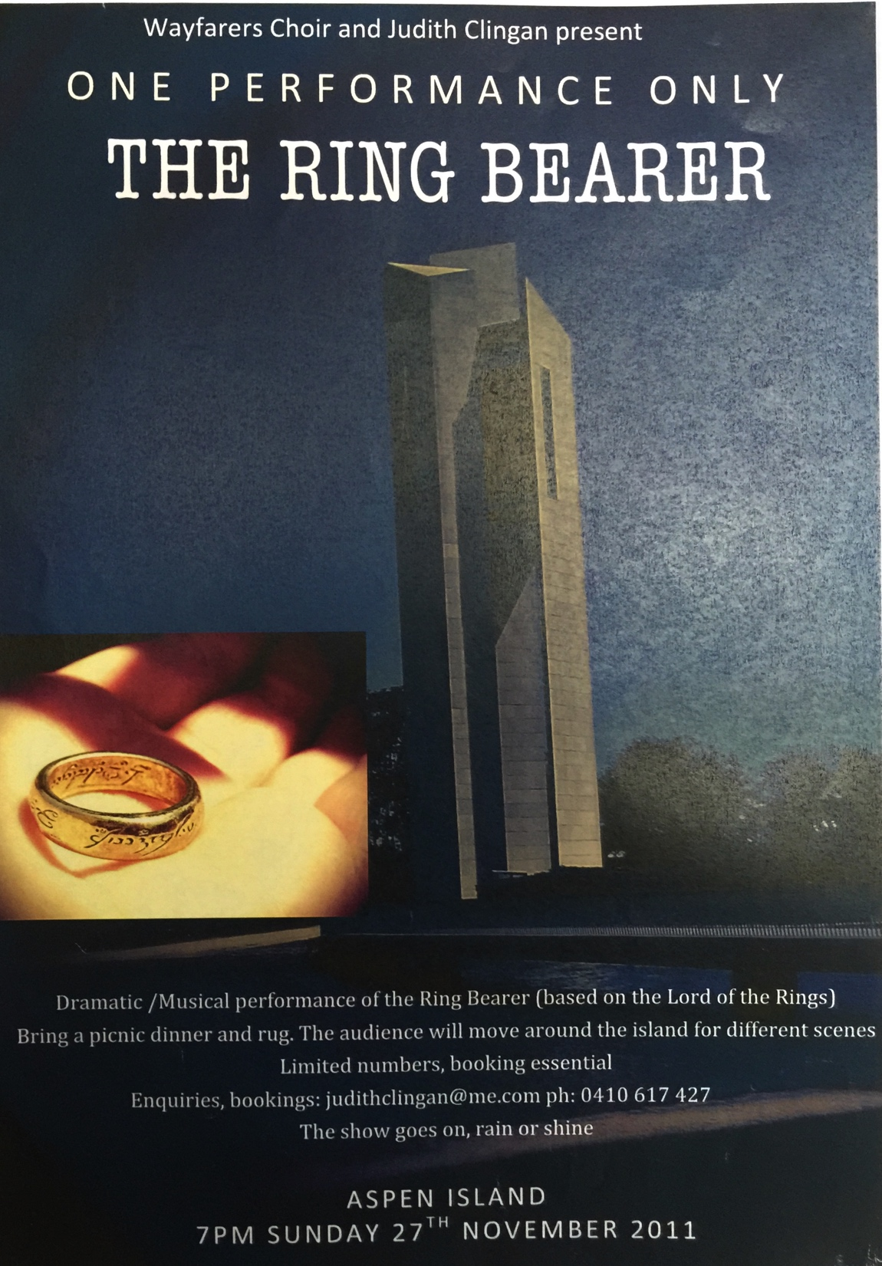
2011
Performance of The Ring Bearer- my adaptation of Tolkien’s The Lord of the Rings, with my music, on Aspen Island

Slide 11
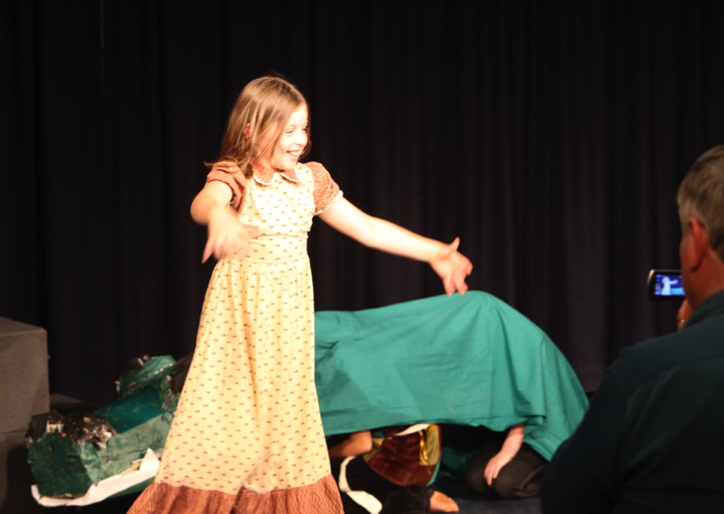
2012 Wayfarers rehearsals Canberra Jan-March for world tour- run three weeks of Imagine Workshops in January as fundraisers for the tour

Slide 12
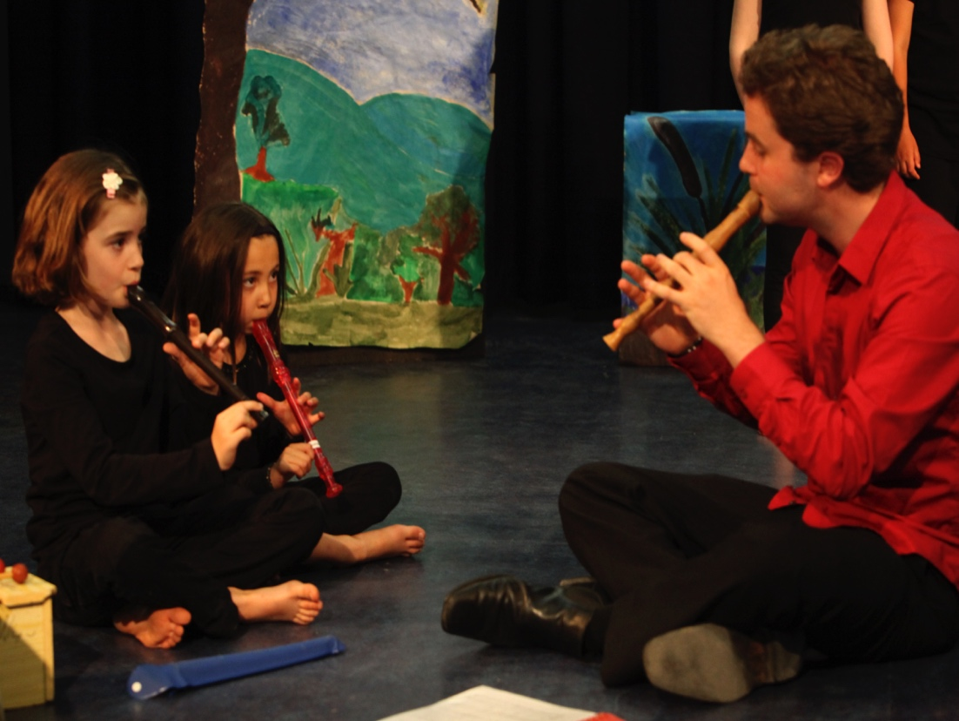

Slide 13
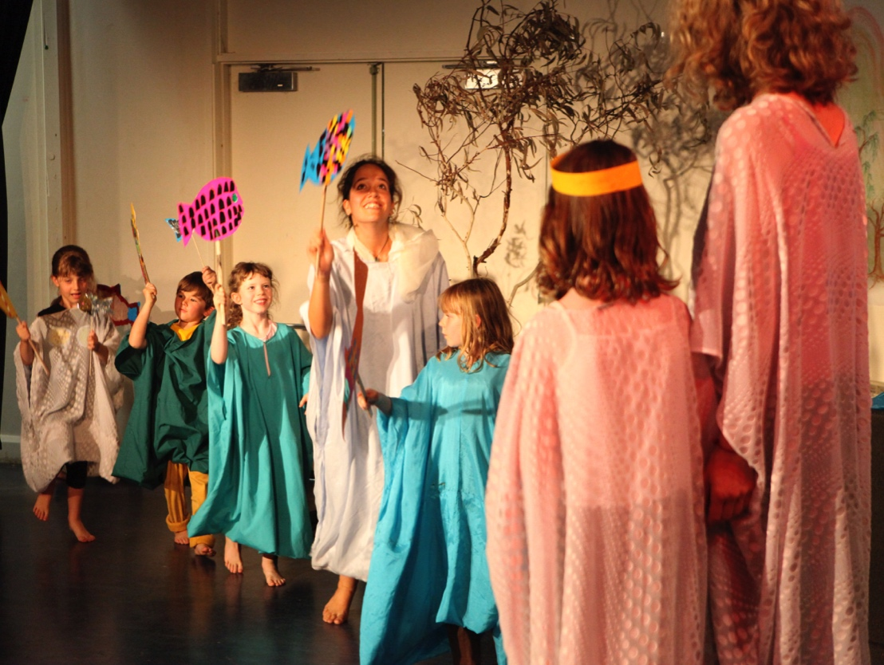

Slide 14
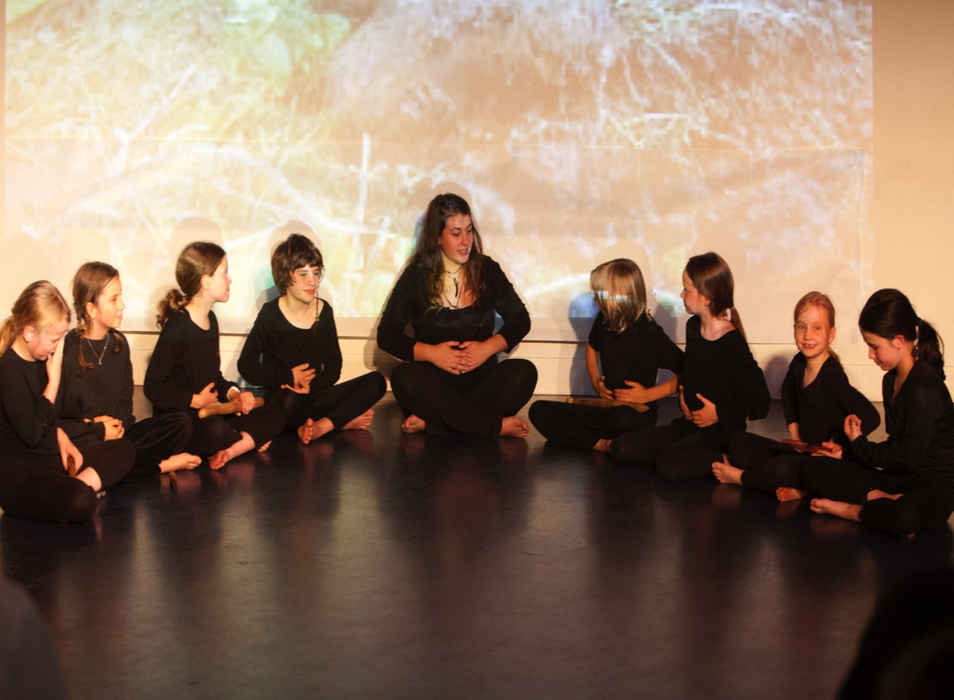
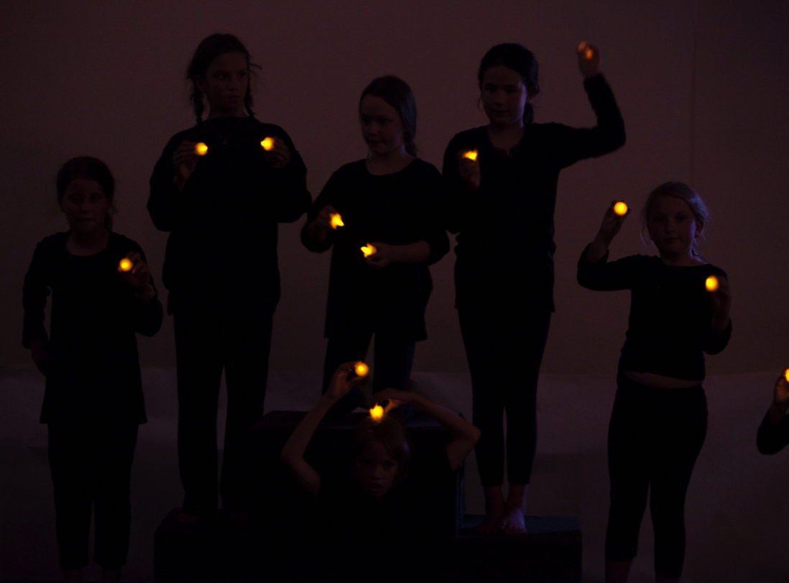

Slide 15
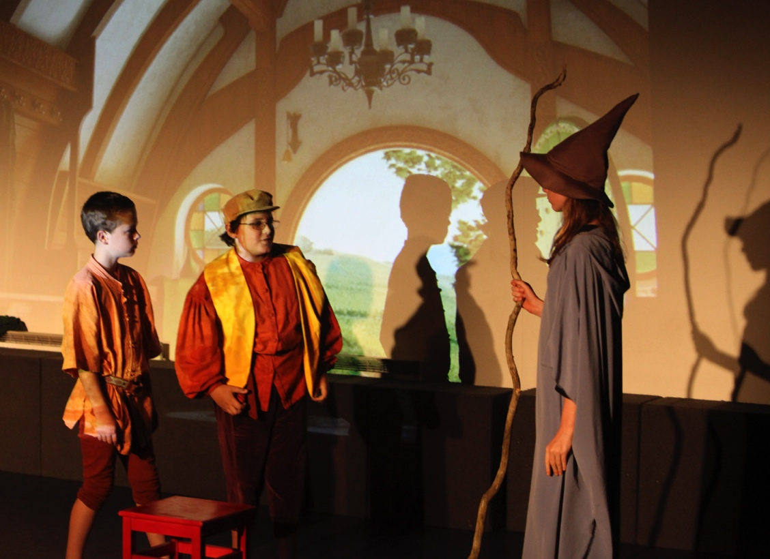

Slide 16
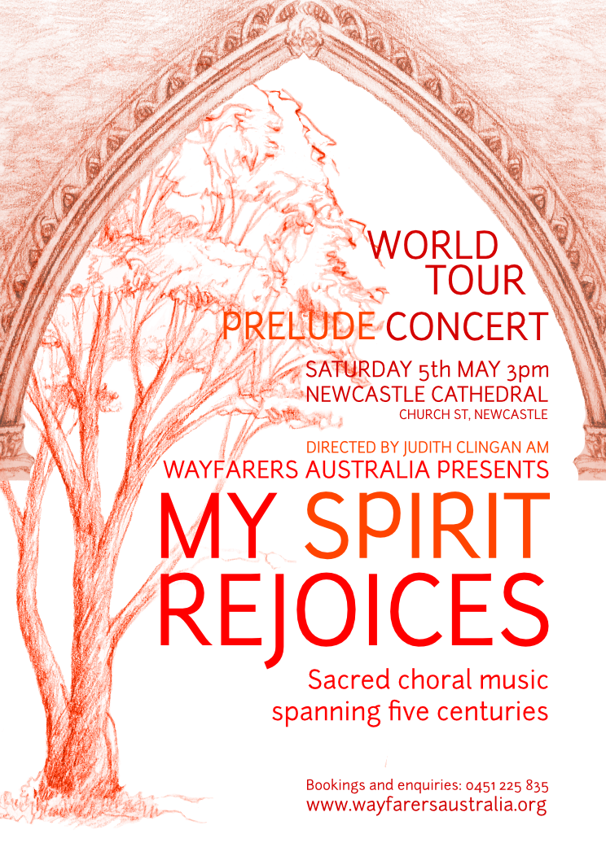
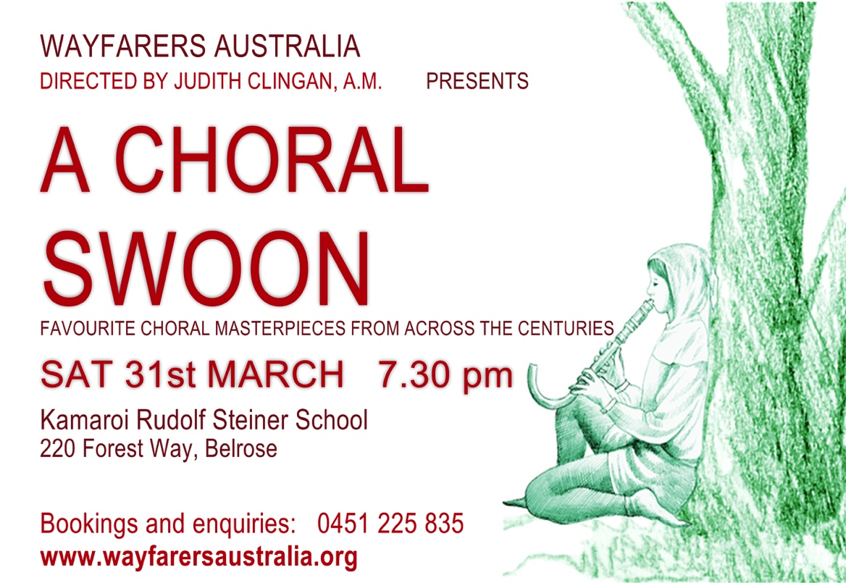
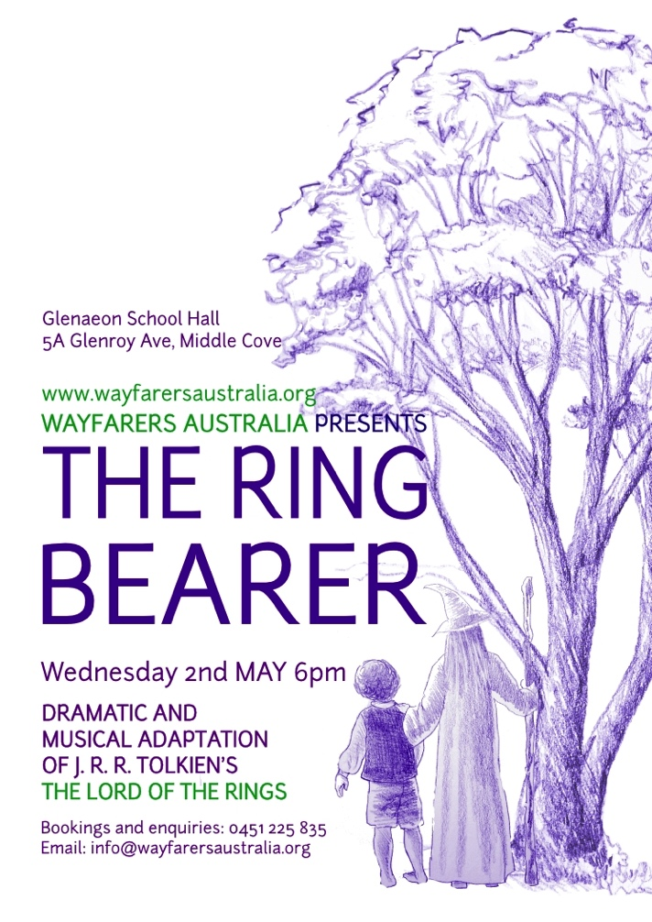
Posters
(Raphaela and Judy) for 2012 world tour

Slide 17
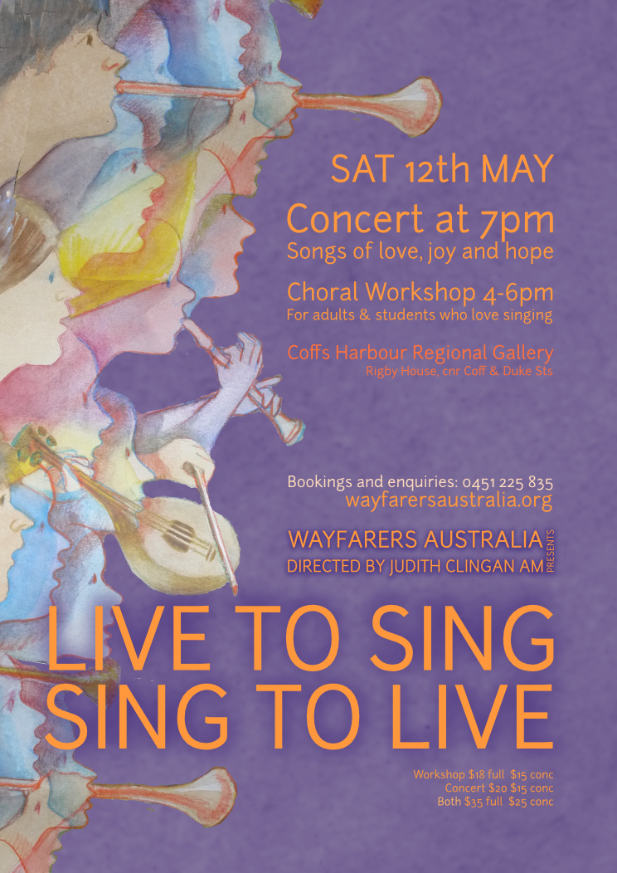
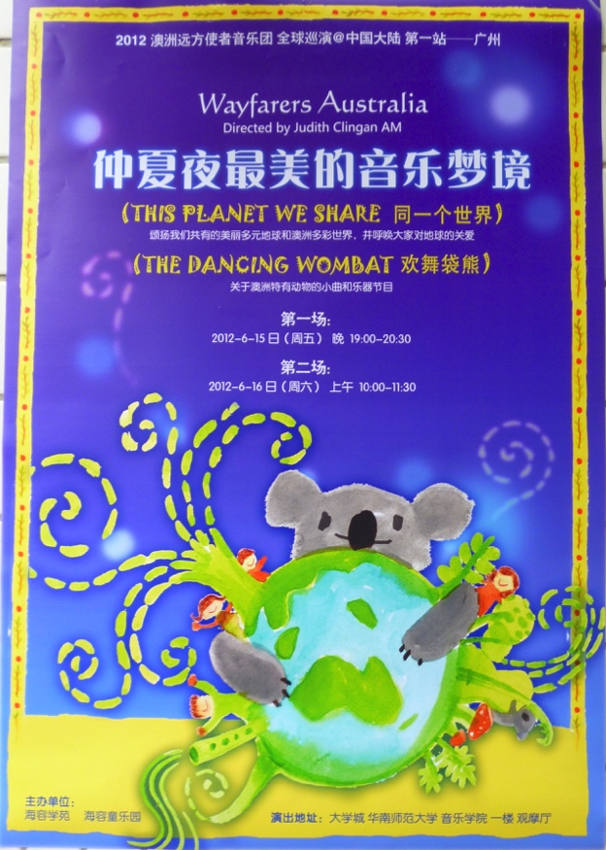
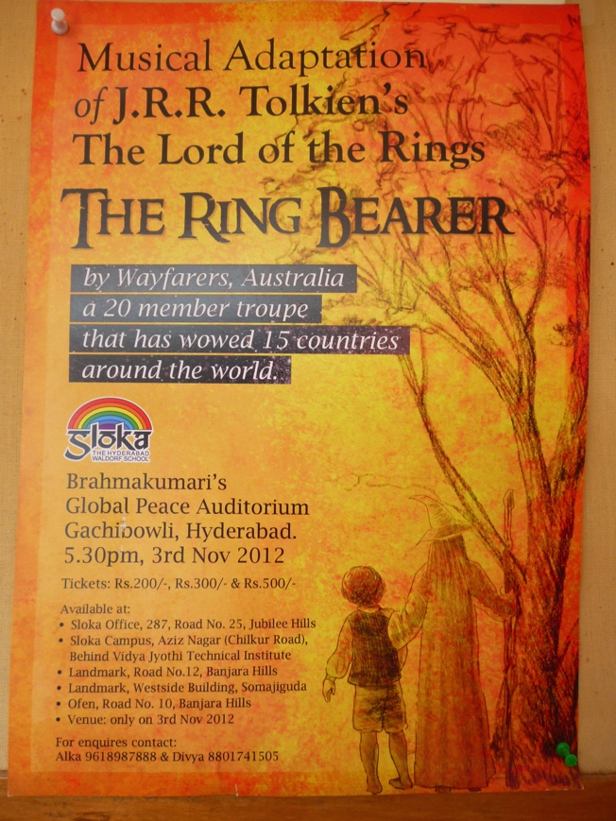
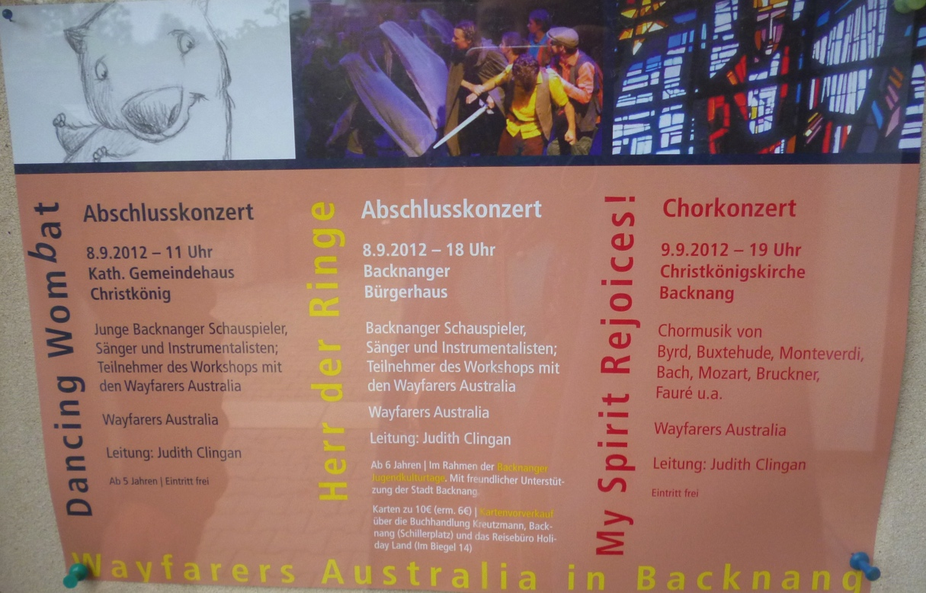
Posters for Australia, China, India, Germany

Slide 18
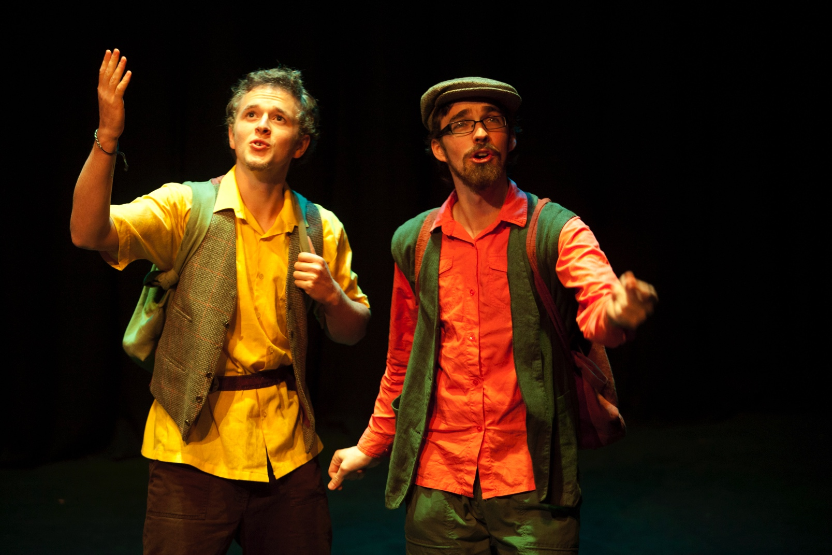
Will Hoffmann, just 18 in 2012, learned the cello to performance standard in 3 months. He has now completed a degree in music. Here we see him as Frodo.
Gawain Davey – composer from Melbourne, who wrote choral vignettes for each member of 2012 Wayfarers, played Sam.

Slide 19
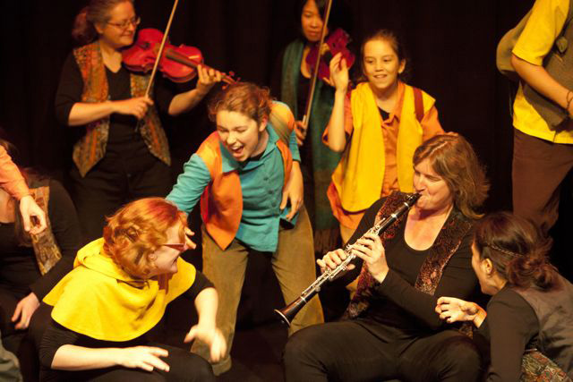
Ellen in the centre, playing Merry, has since 2012 studied Steiner education for 2 years in Melbourne, and is now finishing her degree in music, majoring in singing.

Slide 20
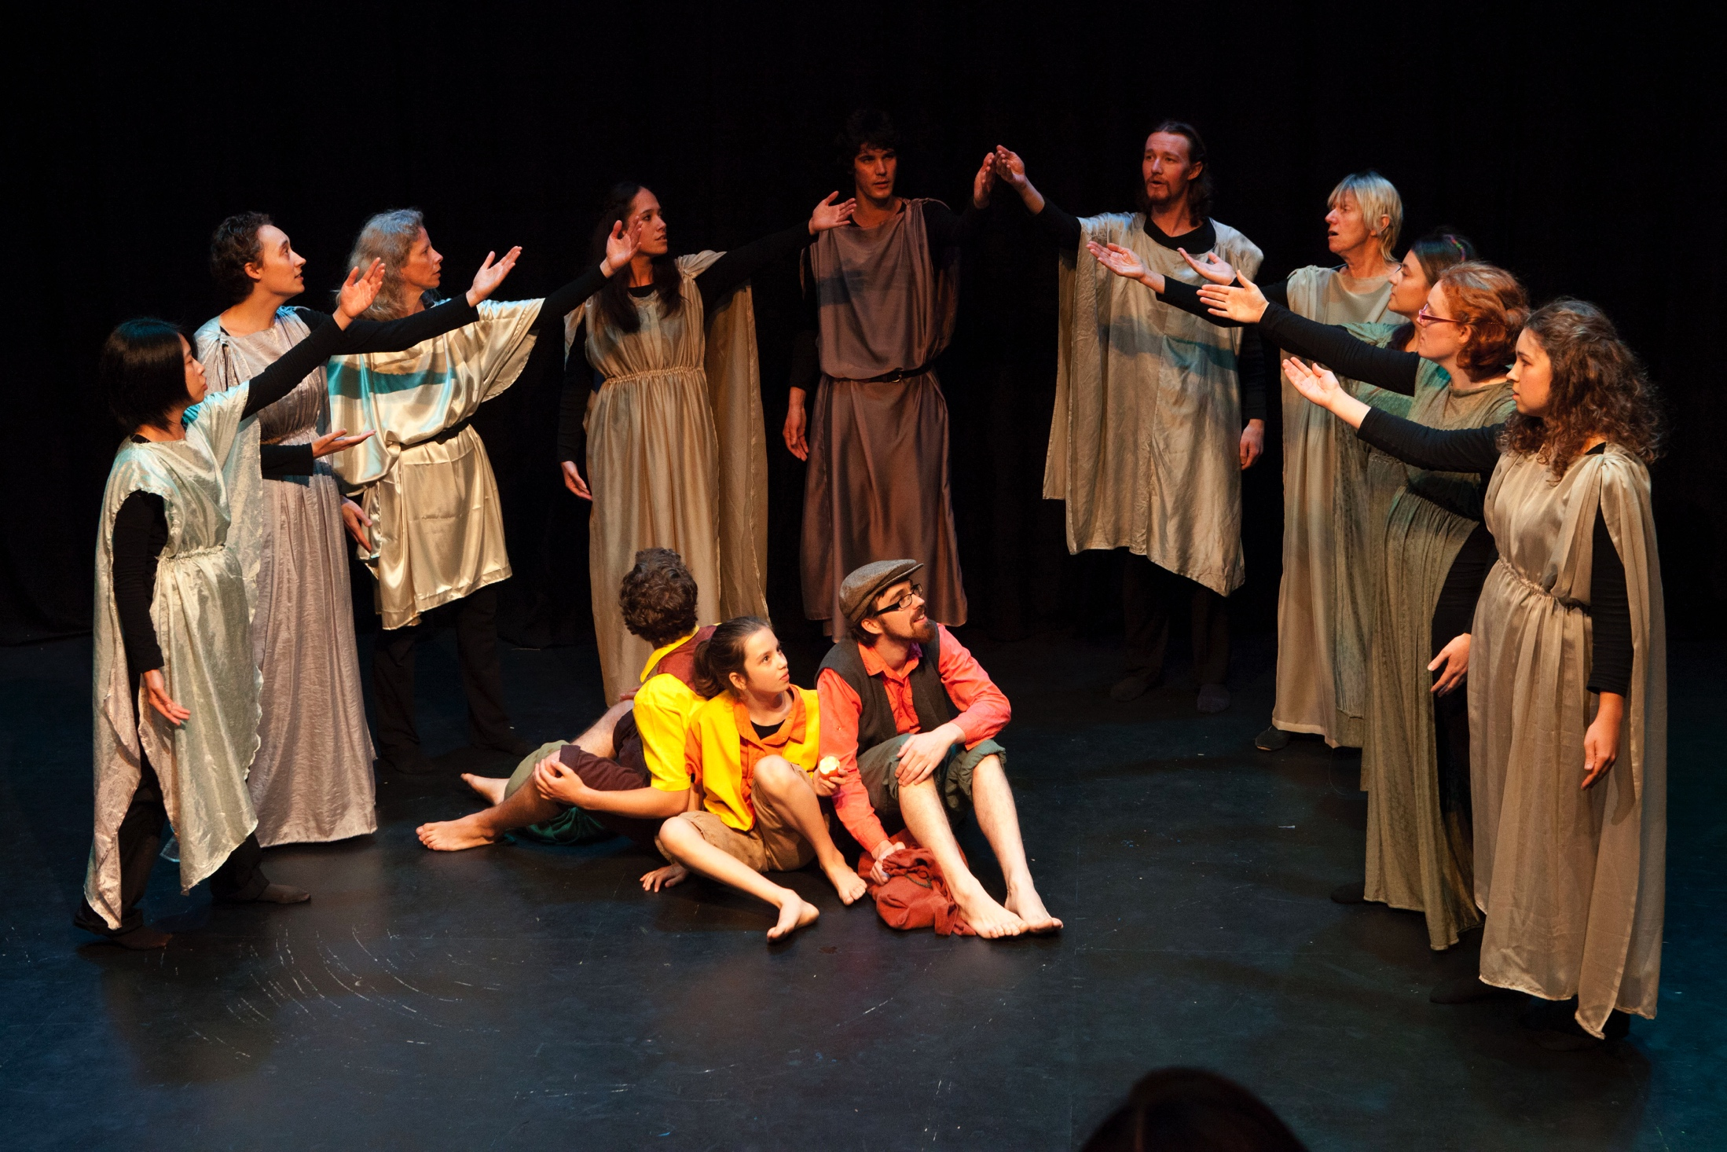
Here we see the Elves singing to Frodo, Sam and Pippin.

Slide 21
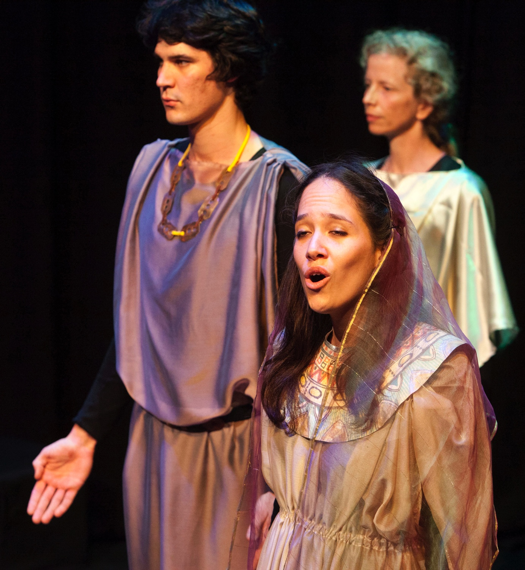
Theo Lillicrap has now completed his degree and is conducting the Glenaeon alumni choir in Sydney. Carmen Rauhut has since studied education. Kia Moon played Galadriel – she is now finishing her teacher training, and aims to start a Steiner school in her father’s homeland, Rapa Nui (Easter Island).

Slide 22
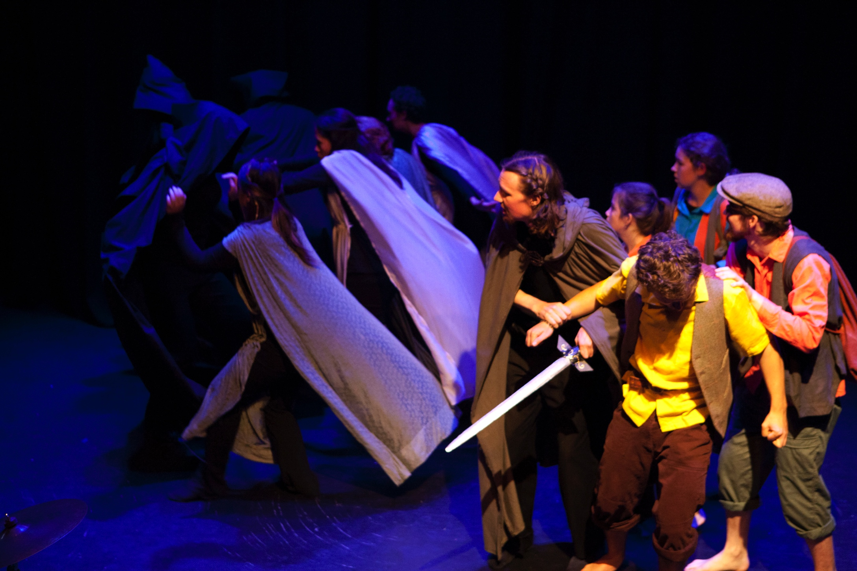
Here we see Elves banishing the Black Riders after the Riders have wounded Frodo.

Slide 23
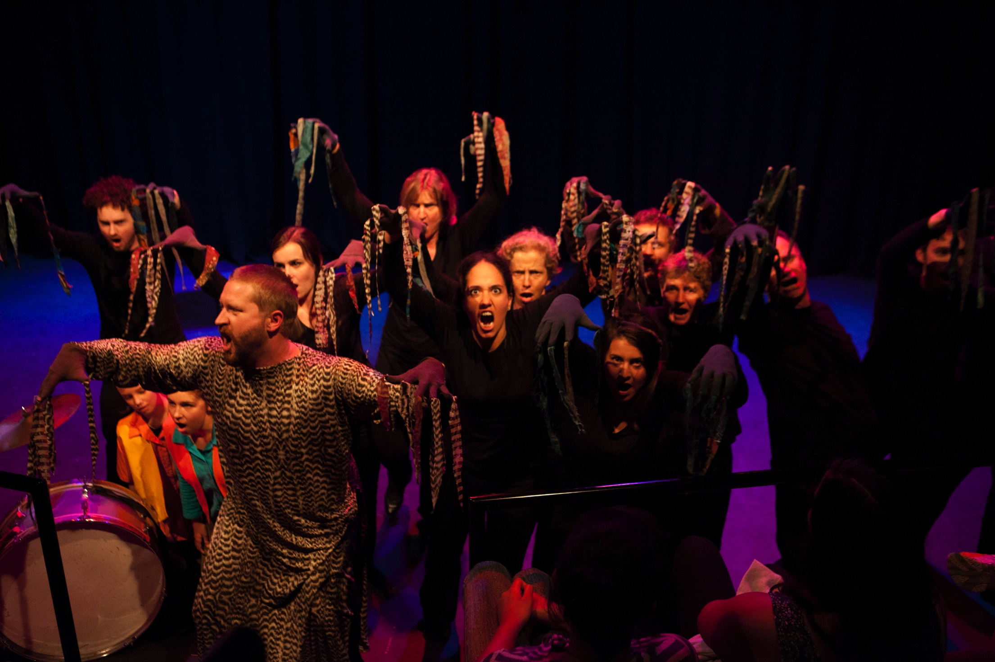
Evan Squire at the front is playing the Ent – here he leads the Ents in battle against Saruman at Isengard.

Slide 24
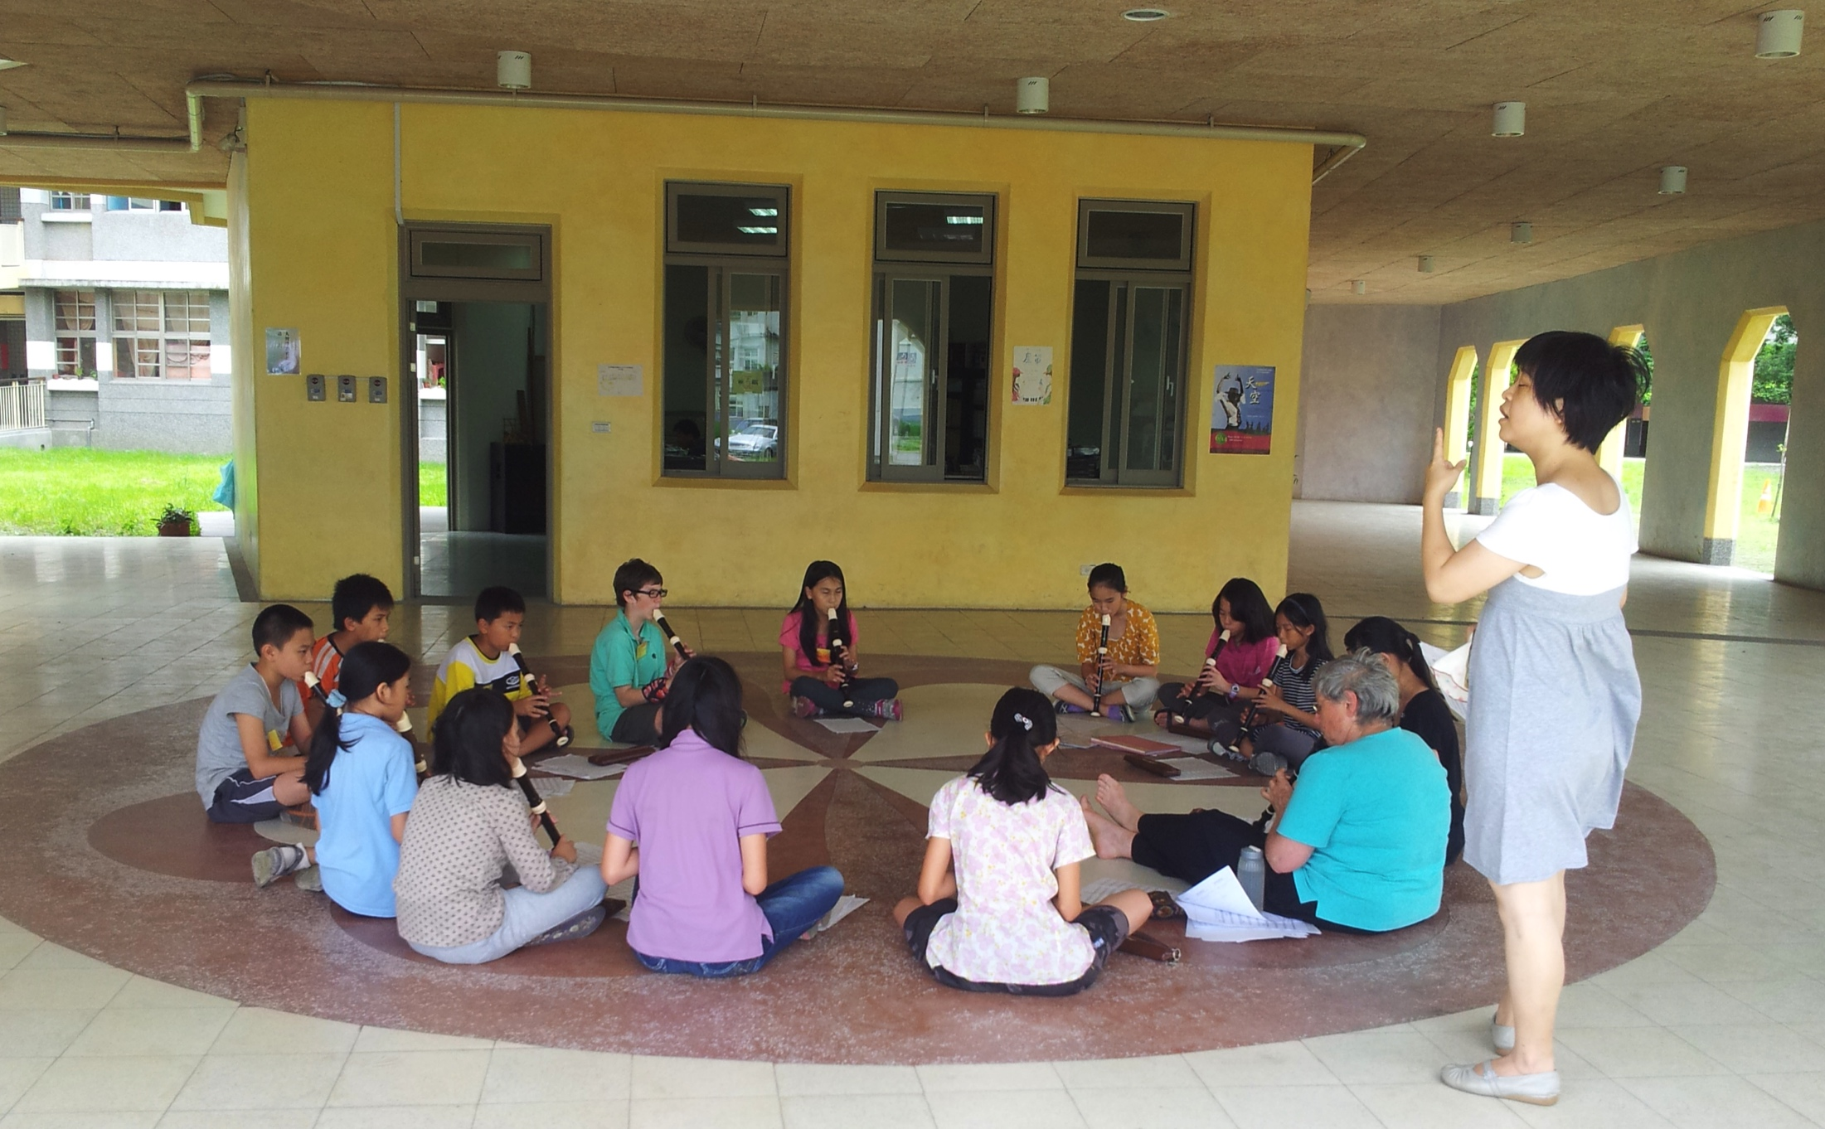
Recorder workshop at Ci-Xin Waldorf School, Yilan, Taiwan – the weather was constantly wet and humid, but the people and the food were wonderful!

Slide 25
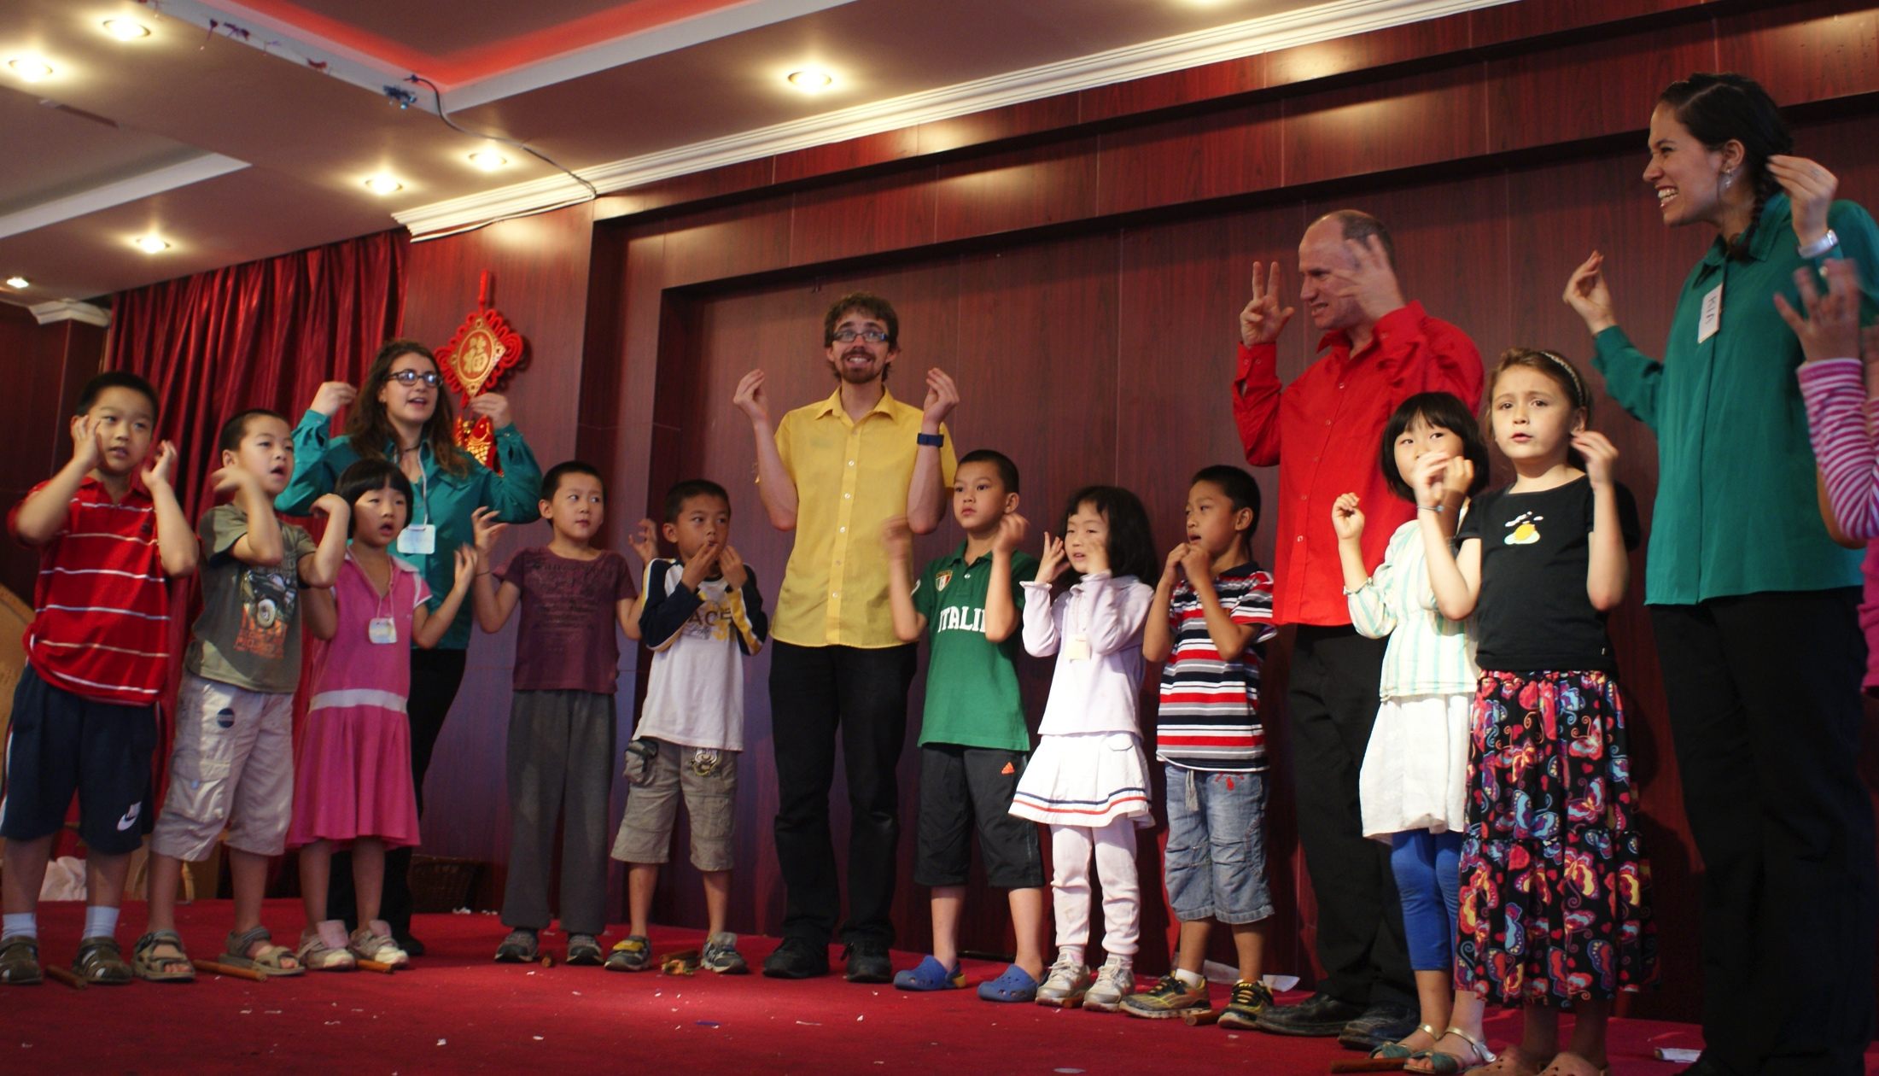
In China, we were hosted by Steiner schools in three cities: Guangzhou, Chengdu and Beijing. Here we are giving a children’s workshop at the Beijing Waldorf School.

Slide 26
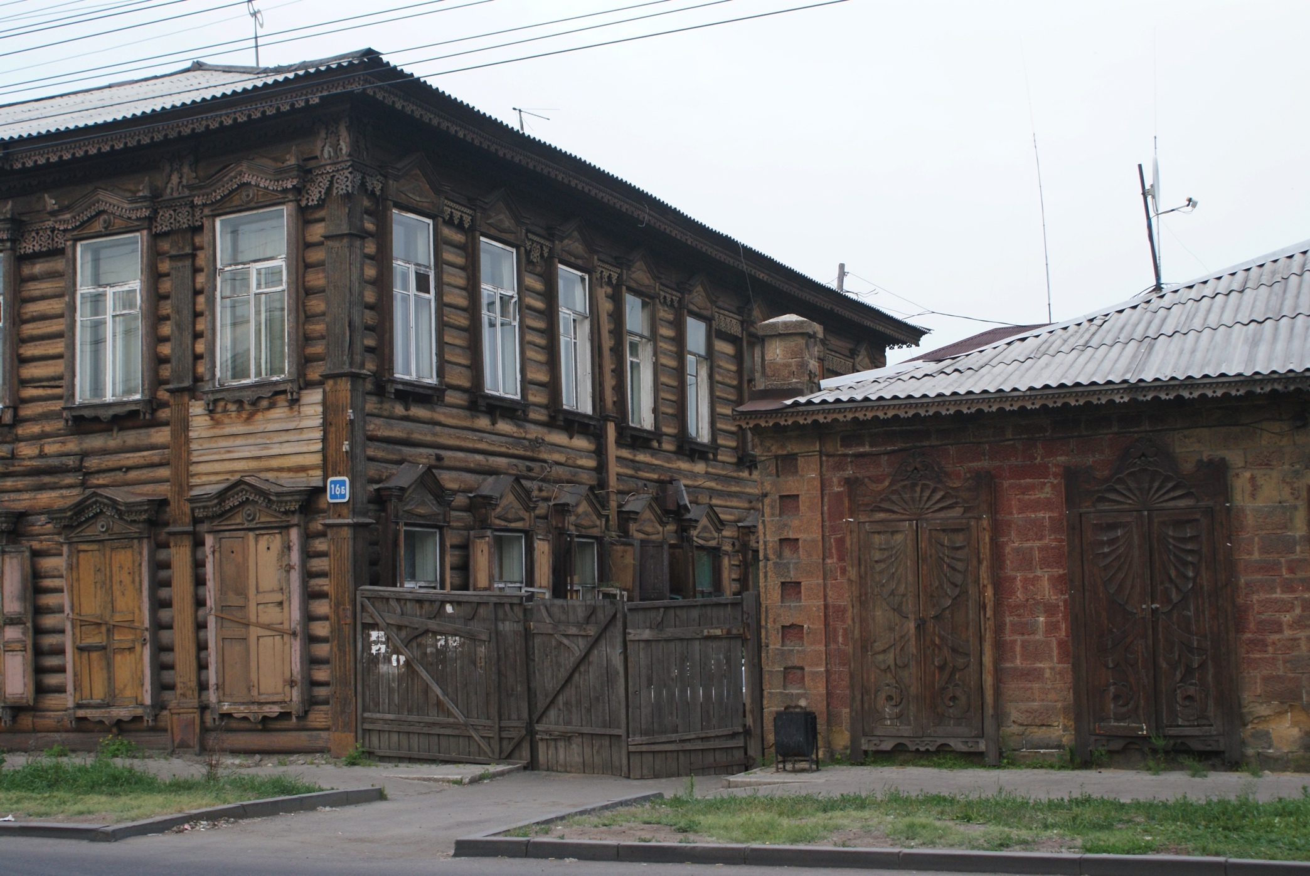
Beautiful old buildings in Irkutsk, shortly before we lose three members of Wayfarers.

Slide 27
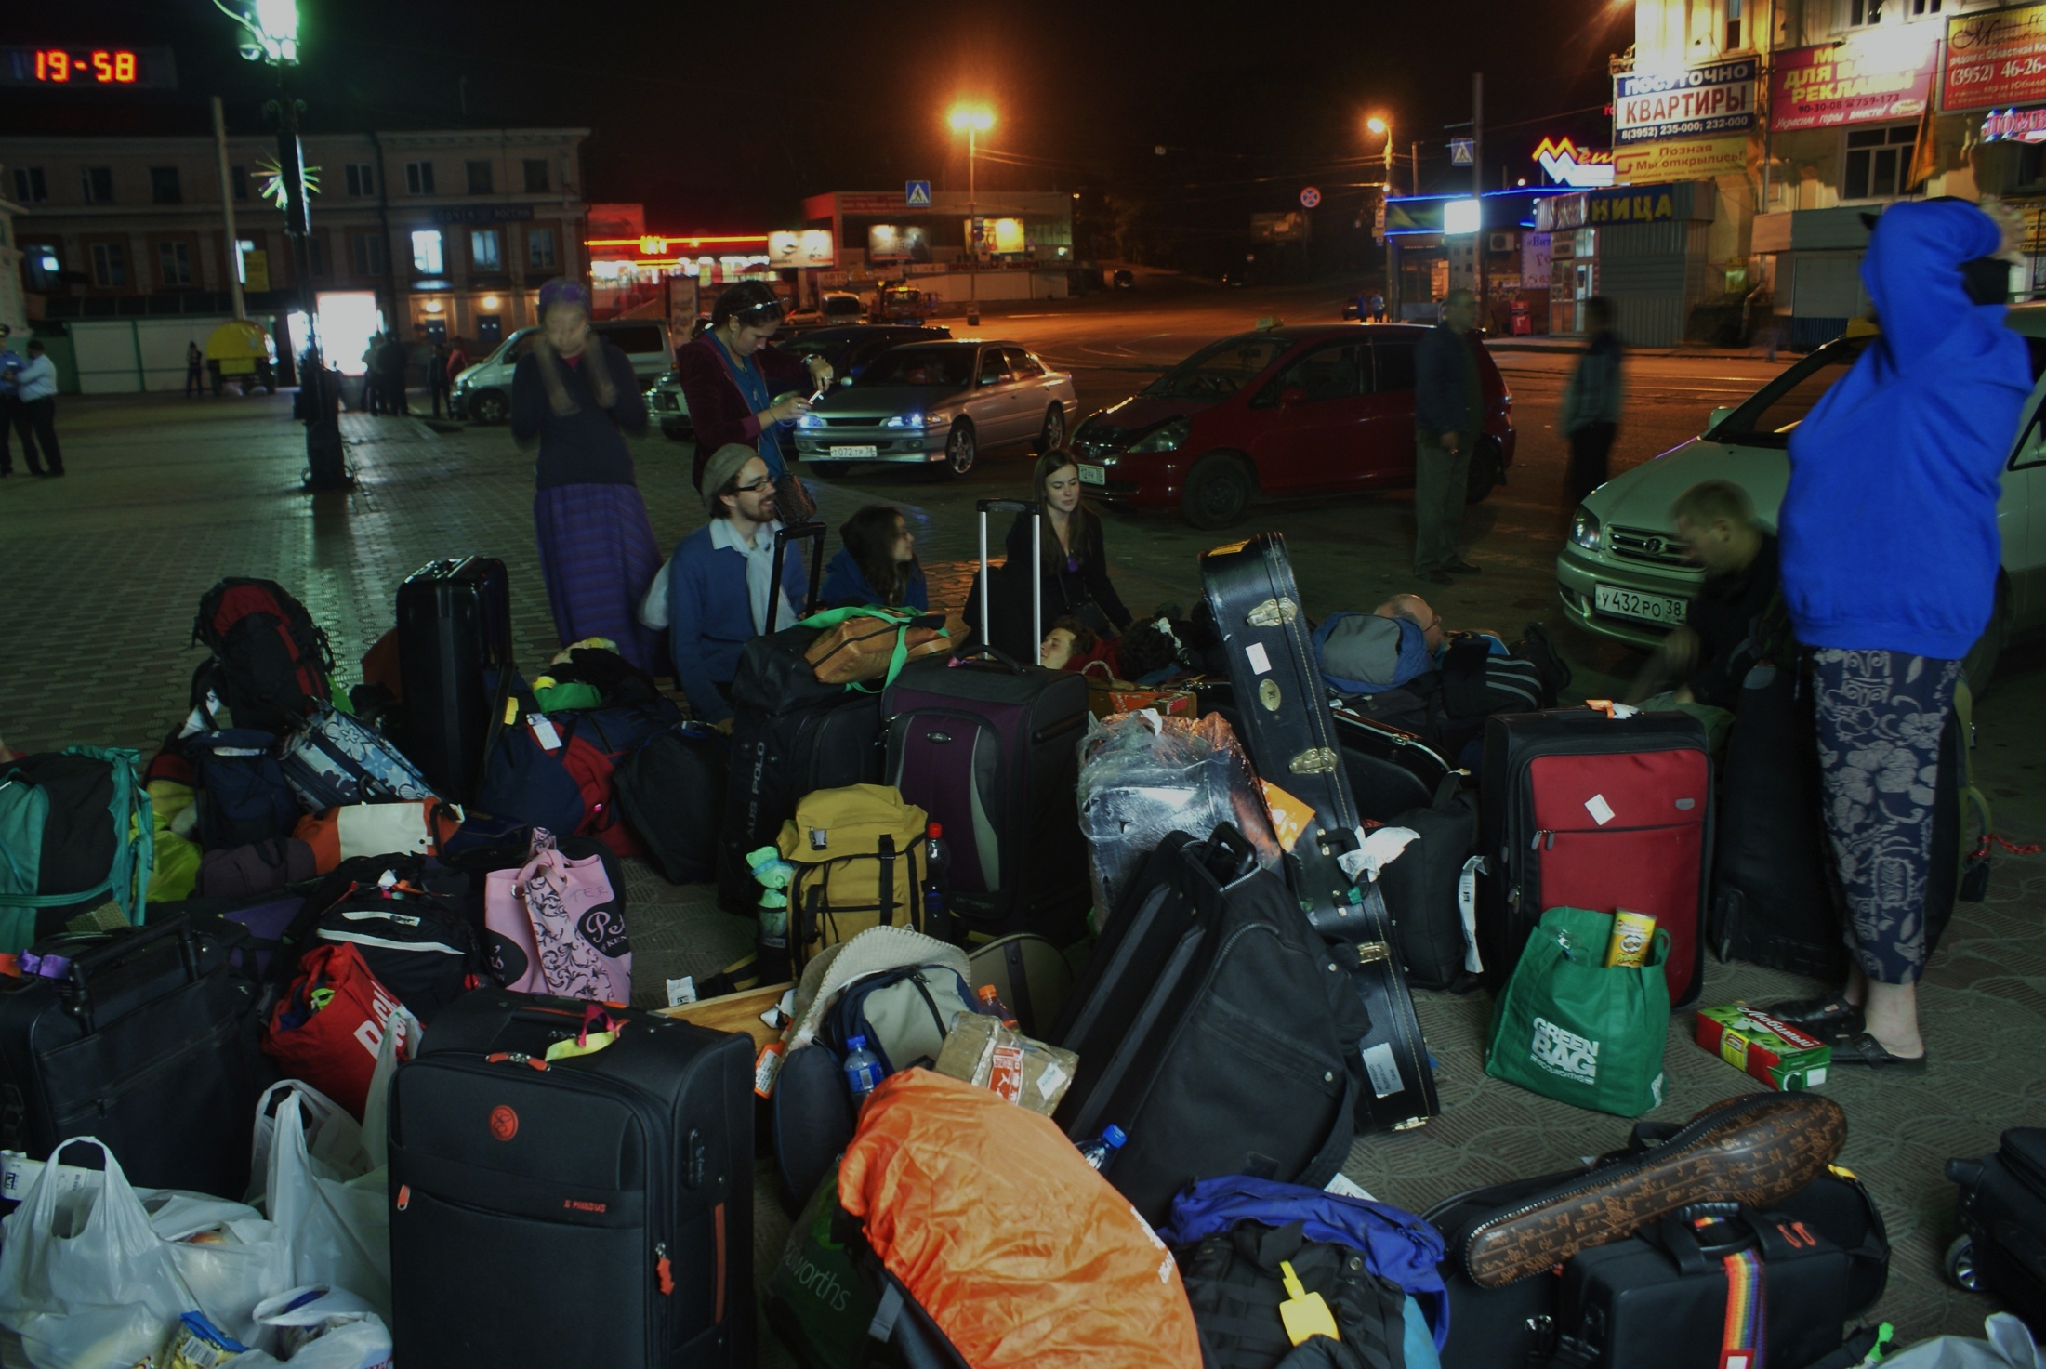
Waiting for the Trans – Siberia railway connection.

Slide 28
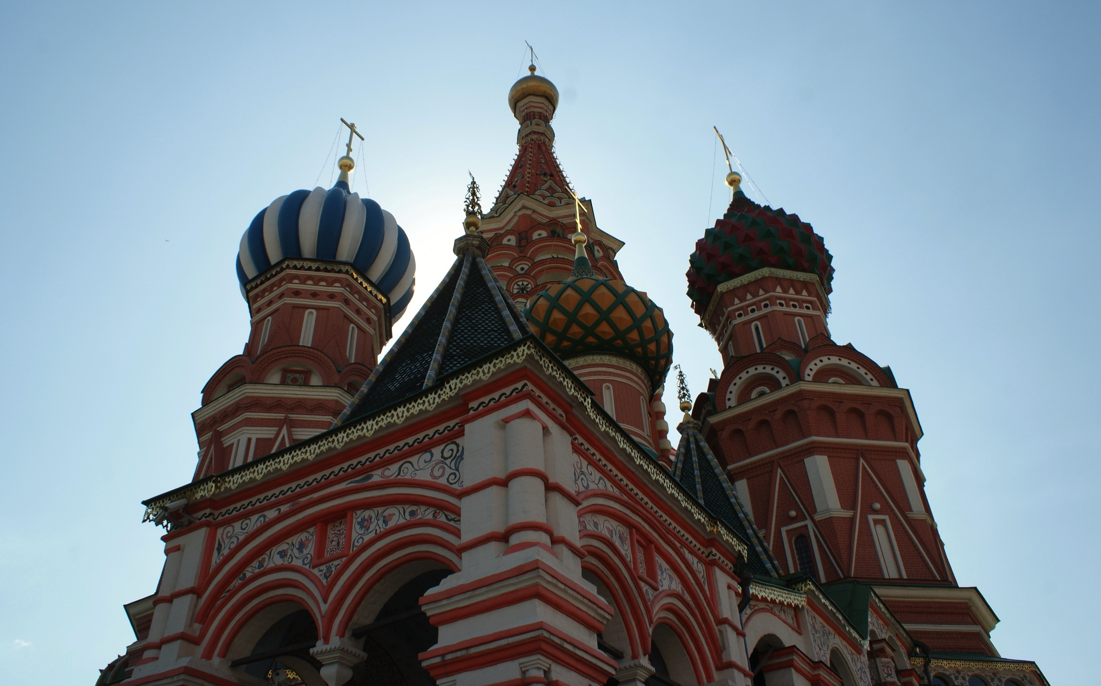
Mosco was both extraordinary beautiful and extraordinary terrible: We were ripped off financially many times eg having to pay twice for our hostel rooms.
After a short concert, we left.

Slide 29
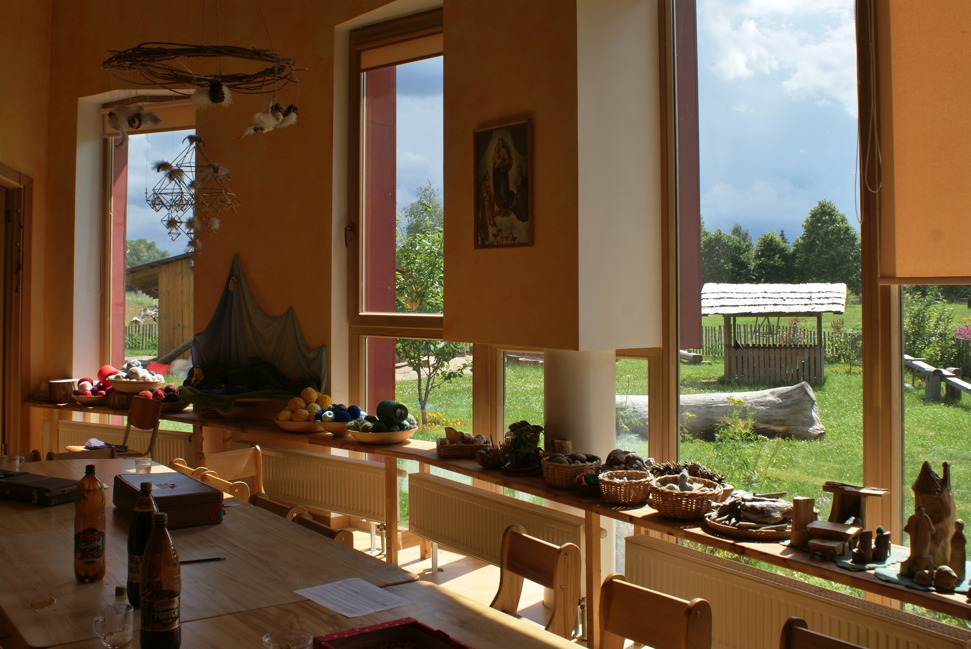
Joyful escape from Russia. As it was school holidays in Latvia, we were given the run of Riga Waldorf School for accommodation. (The kindy beds were a little short! )

Slide 30
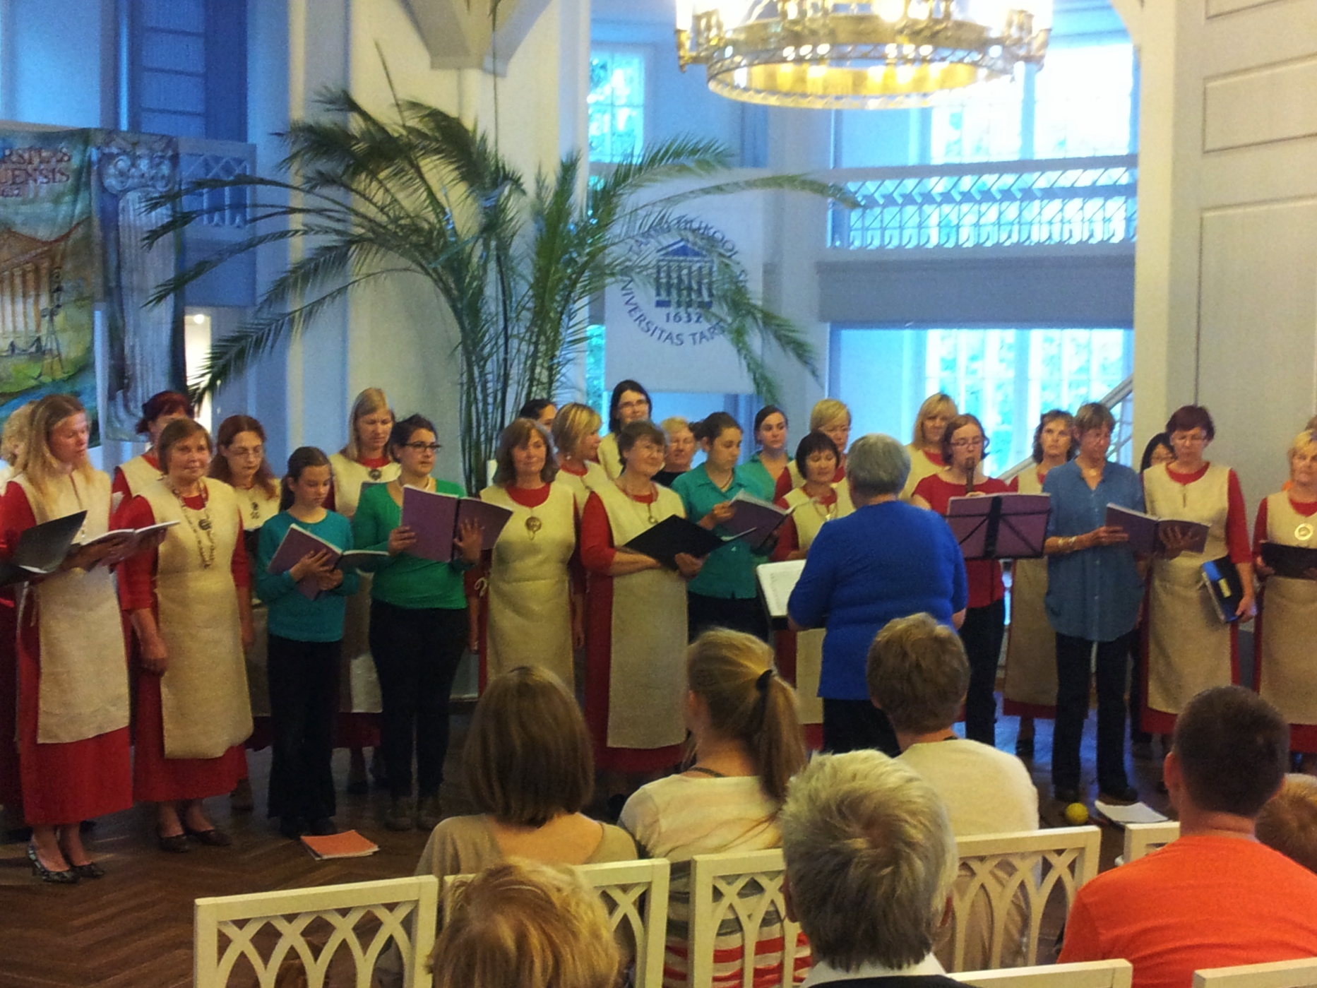
a
In Estonia, we were extremely fortunate to be hosted by a women’s choir. Besides giving combined and separate performances all over the country, we were treated to traditional food, music, dance and crafts everywhere we went.

Slide 31
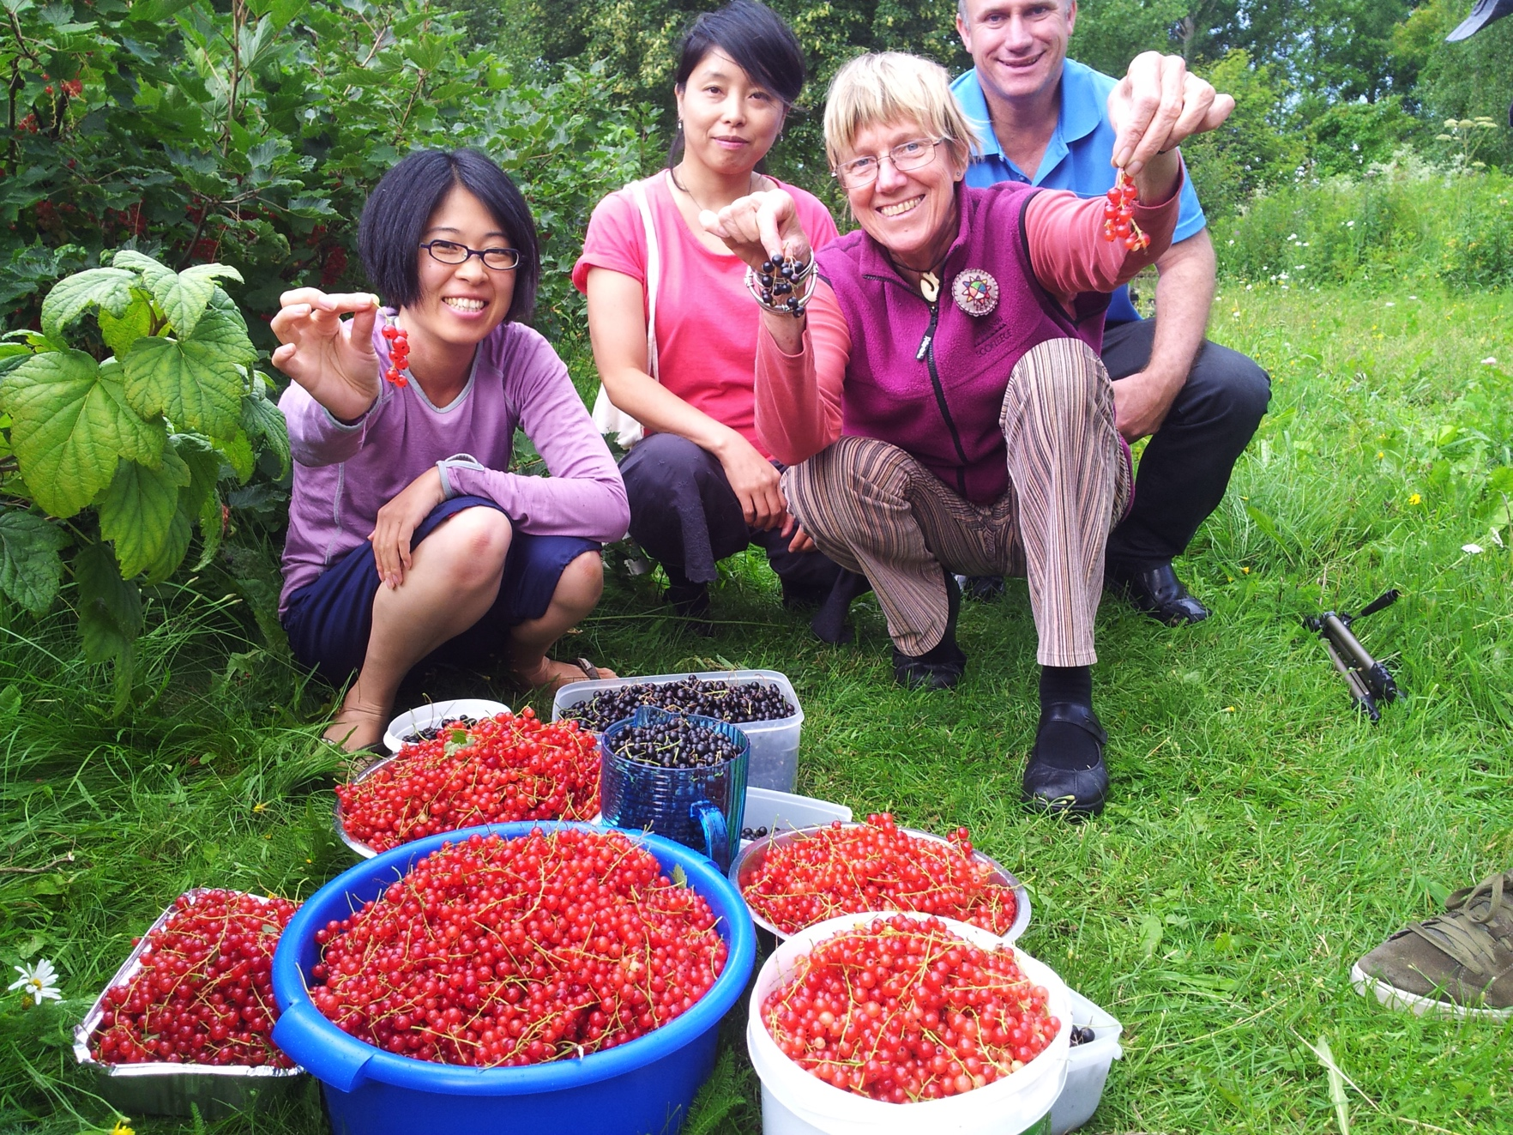
It was school holidays in Finland also. We spent a marvellous ten days at the Sylvia Koti Camphill, giving performances and workshops to the small number of residents and carers who were still there. We also helped harvest the berries!

Slide 32

We returned unwillingly to Russia, this time to St. Petersburg, as we had entered the choir festival and competition, the Singing World.

Slide 33
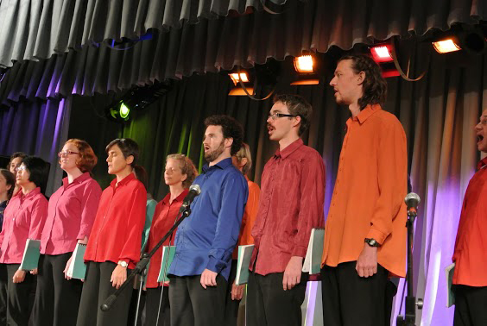
As part of Festival, participating choirs were given several opportunities to perform – here we are giving a concert of Australian repertoire.

Slide 34
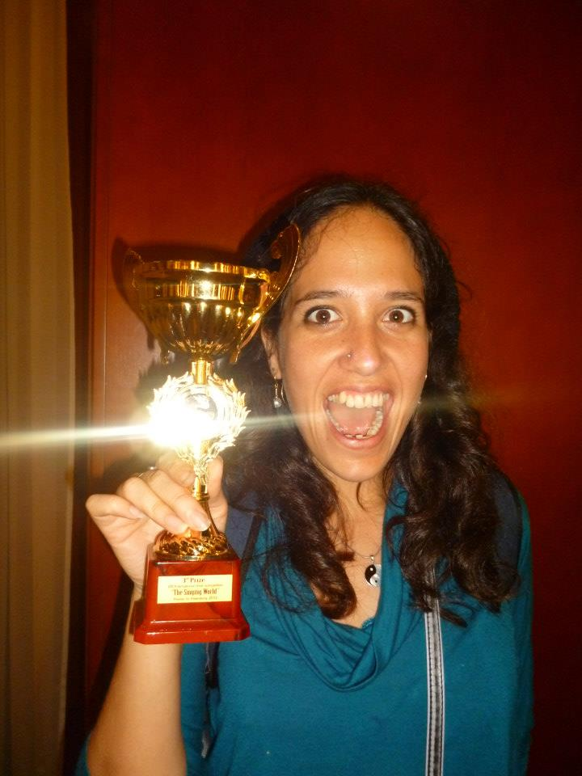
First (or was it second?) prize in Women’s Choirs at the Singing World Festival and Competition, St. Petersburg.
Kia Moon with our cup!

Slide 35
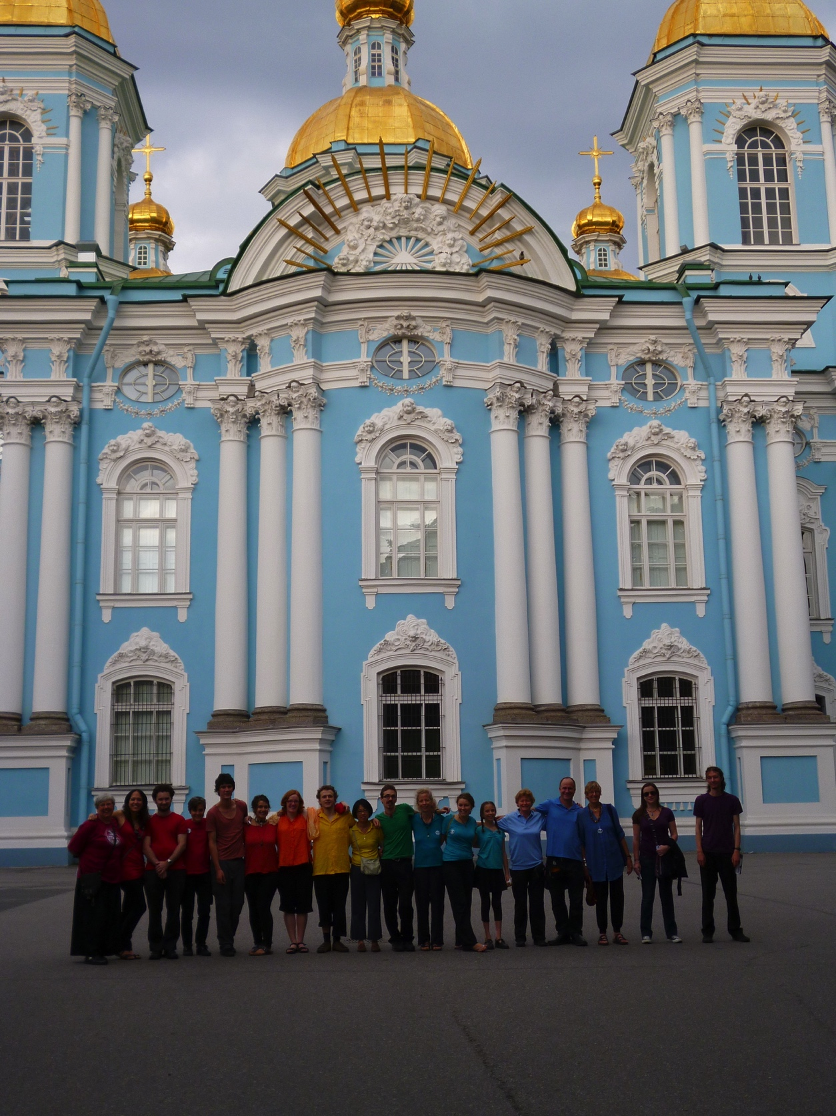
Resplendent in our rainbow shirts outside a cathedral in St. Petersburg.

Slide 36
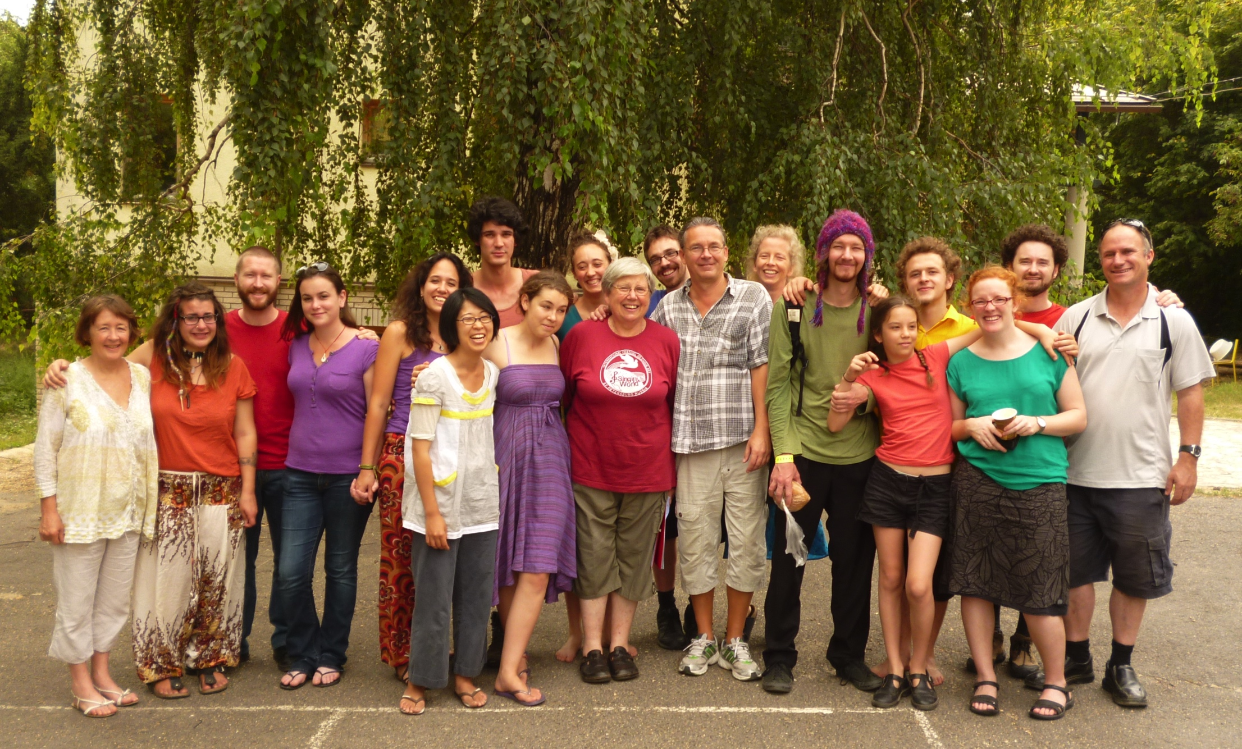
In Hungary, we were extremely happy to spend a week with Lazsi Varga and his young adult choir of Budapest Waldorf School alumni.

Slide 37
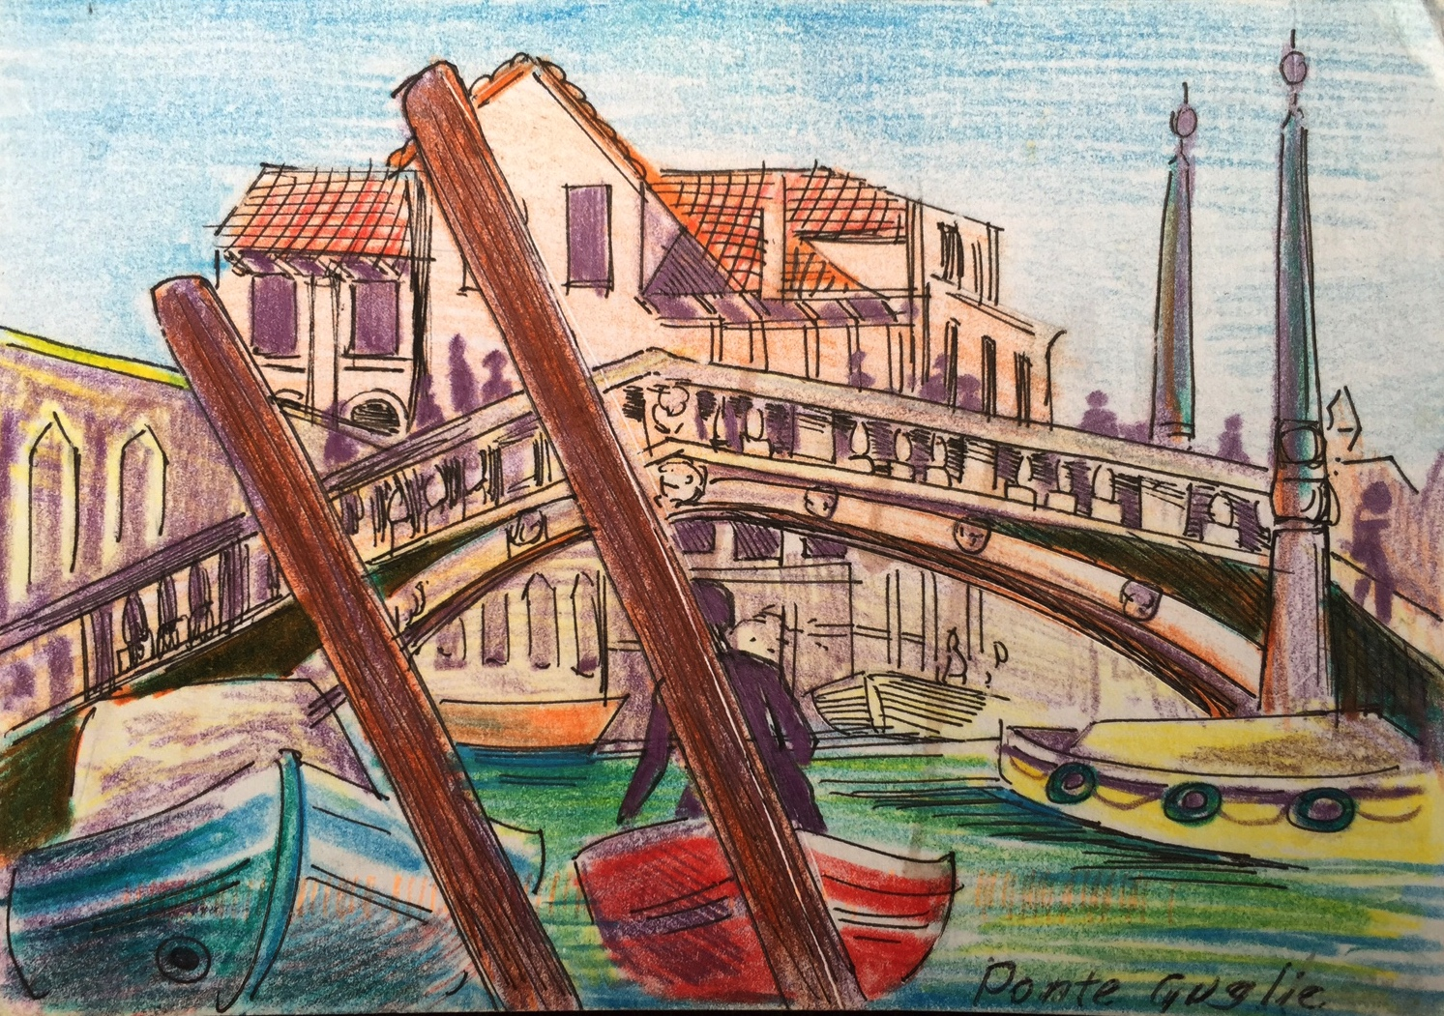
Our time in Italy was mostly leisure – enjoying Gondola rides at midnight etc! We also gave a lunch time concert in St. Mark’s, Venice – where Gabrieli’s and Monteverdi’s sacred masterpieces were performed in the 17th century.

Slide 38
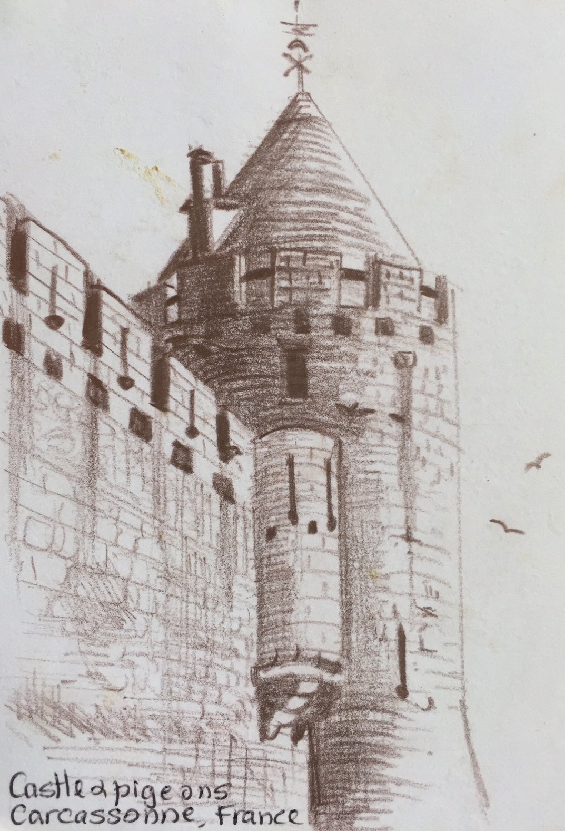
France gave us the chance to visit Taizé again. We also enjoyed singing medieval music in the medieval town Carcassonne.

Slide 39
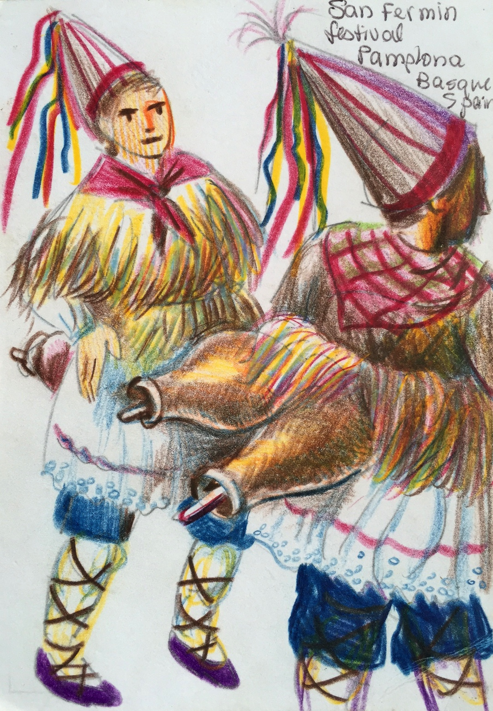
The more fit and intrepid (usually = younger!), then spent a week walking the Camino – the medieval pilgrimage route through France and Spain. I lasted one and a half days, then for the rest of the week enjoyed Pamplona, which was in the middle of its Running of the Bulls Festival.

Slide 40
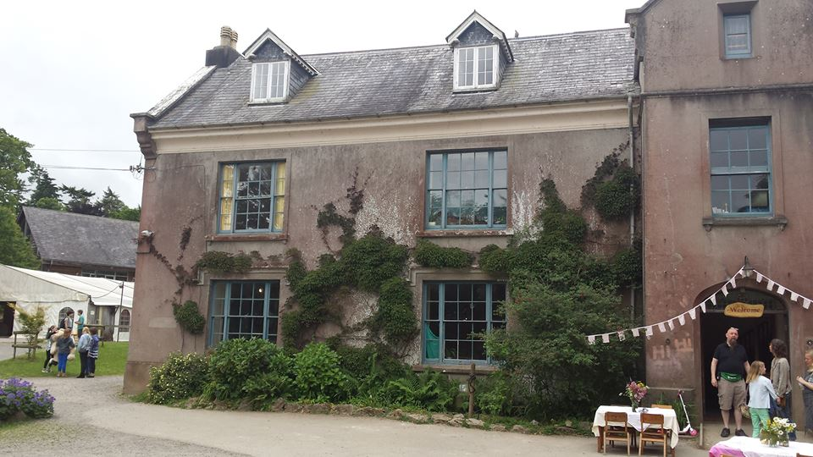
After a church concert in Bilbao, Northern Spain, we crossed the channel and were hosted by the South Devon Steiner School in Totnes. Here we met a wonderful music teacher, Kate, whose students were a delight to teach.

Slide 41
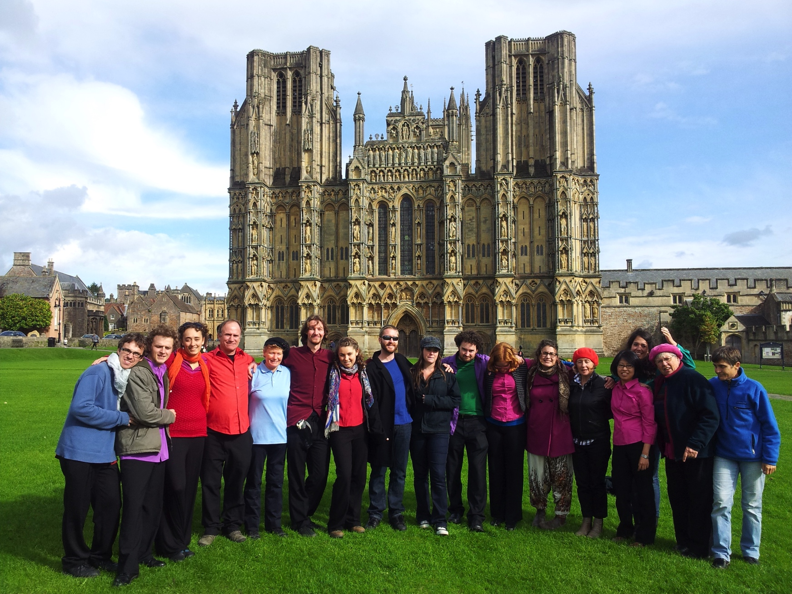
Wells Cathedral has one of the most beautiful acoustics for choral music – like milk and honey!

Slide 42
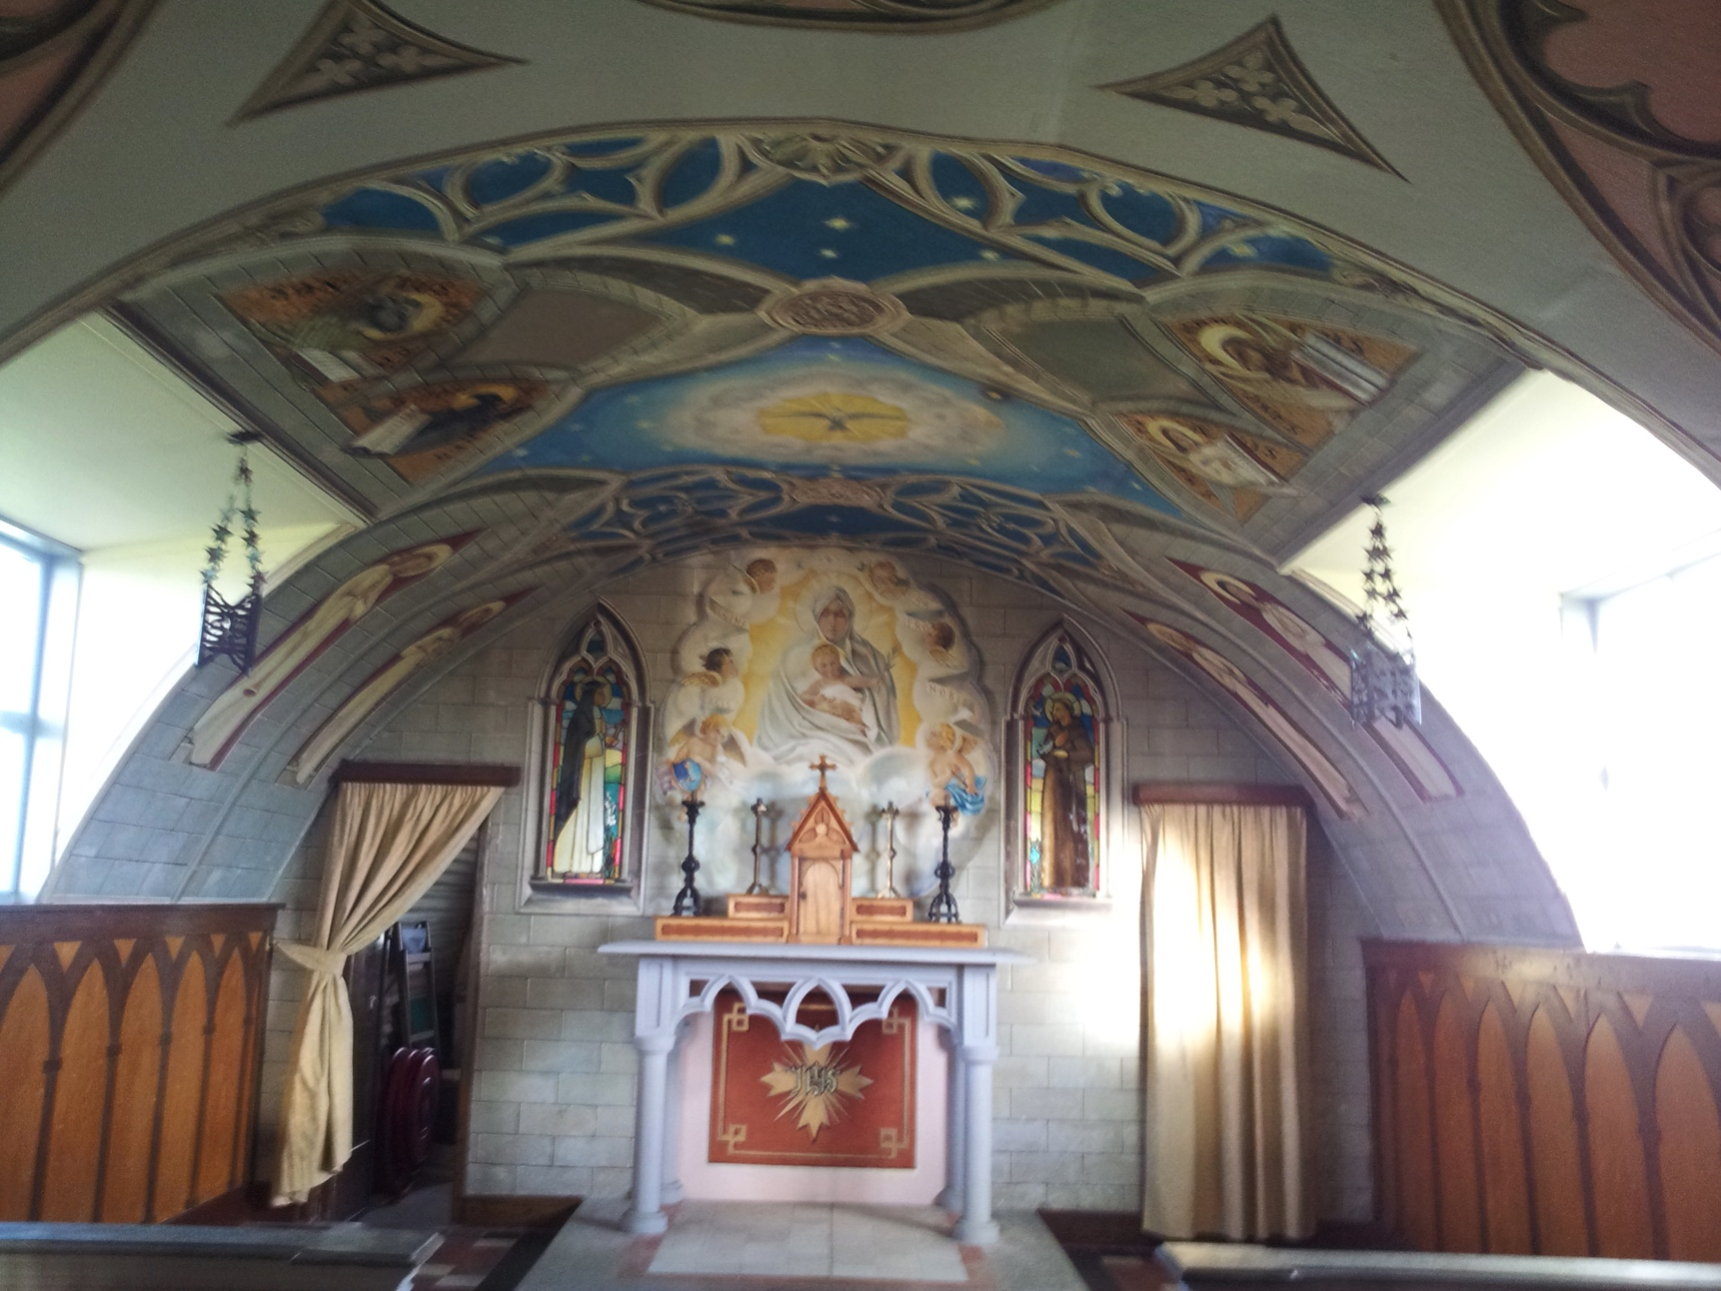
We drove from England to Findhorn, where we sang chants at dawn every morning in the stone hobbit house. From there, we took a ferry to the Orkney Islands, where we performed in both St. Magnus Cathedral and in the Italian chapel on Lamb’s Holm.

Slide 43
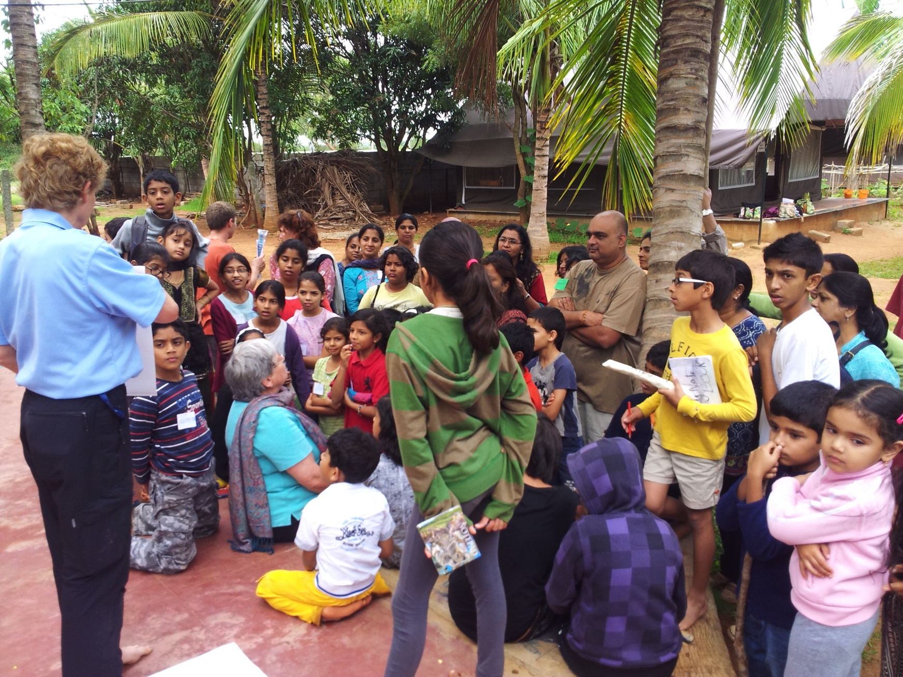
Our last country on our world tour was India. First we spent a beautiful week at the Bangalore Steiner School.

Slide 44
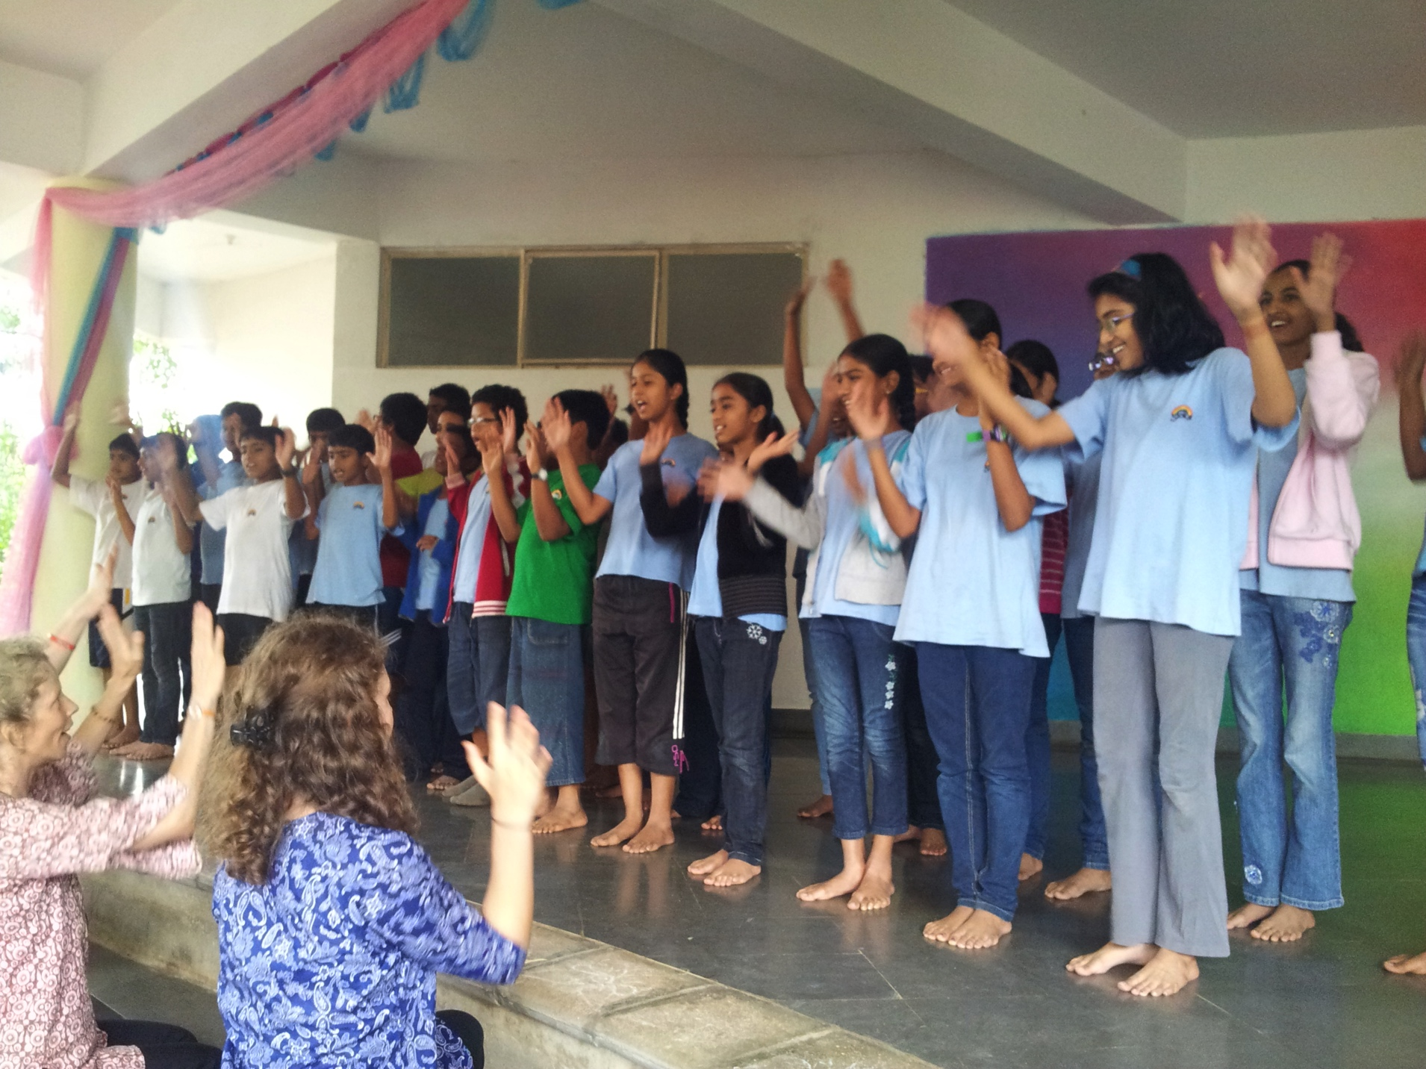
Sloka school in Hyderabad, India

Slide 45

Lined up on the staircase at the Sloka Steiner school in Hyderabad – I’m holding my great bass gemshorn, recently bought at the early music shop in England.

Slide 46


Kaoru from Japan – I met her in New Zealand while teaching at Taruna Rudolf Steiner Teacher Training College. She is now a teacher at a Steiner school in Tokyo.
Manuka, aged 12 – the youngest member of 2012 Wayfarers – now turning 18, and about to spend a year in Europe - part of it as a volunteer at Taizé.

Slide 47


Kate and Matt have both been members of my various Canberra performance ensembles since childhood. The 2012 tour cemented their decision to marry. And the months of teaching we all shared in on tour led Matt to undertake teacher training on our return to Australia.
Rohan Vicars has been a dedicated Wayfarer since the age of 11. On our return to Australia, Rohan finished his degree and Dip Ed, and studied Steiner education for 2 years in Melbourne, where he is now a Steiner teacher.

